Slide 1
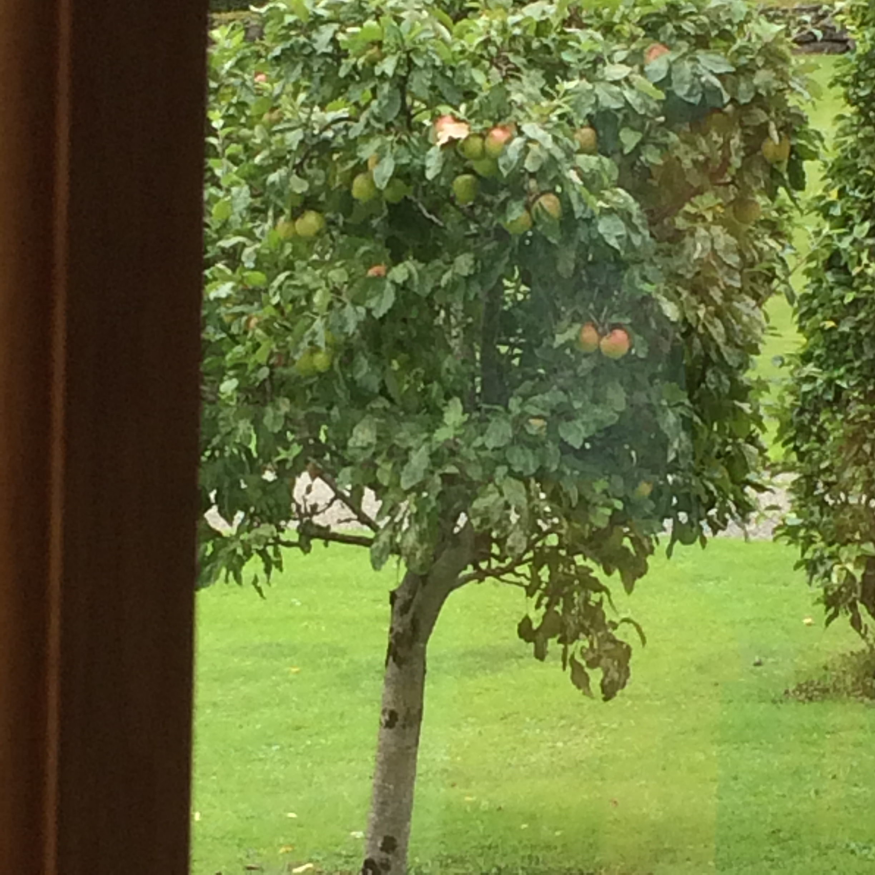
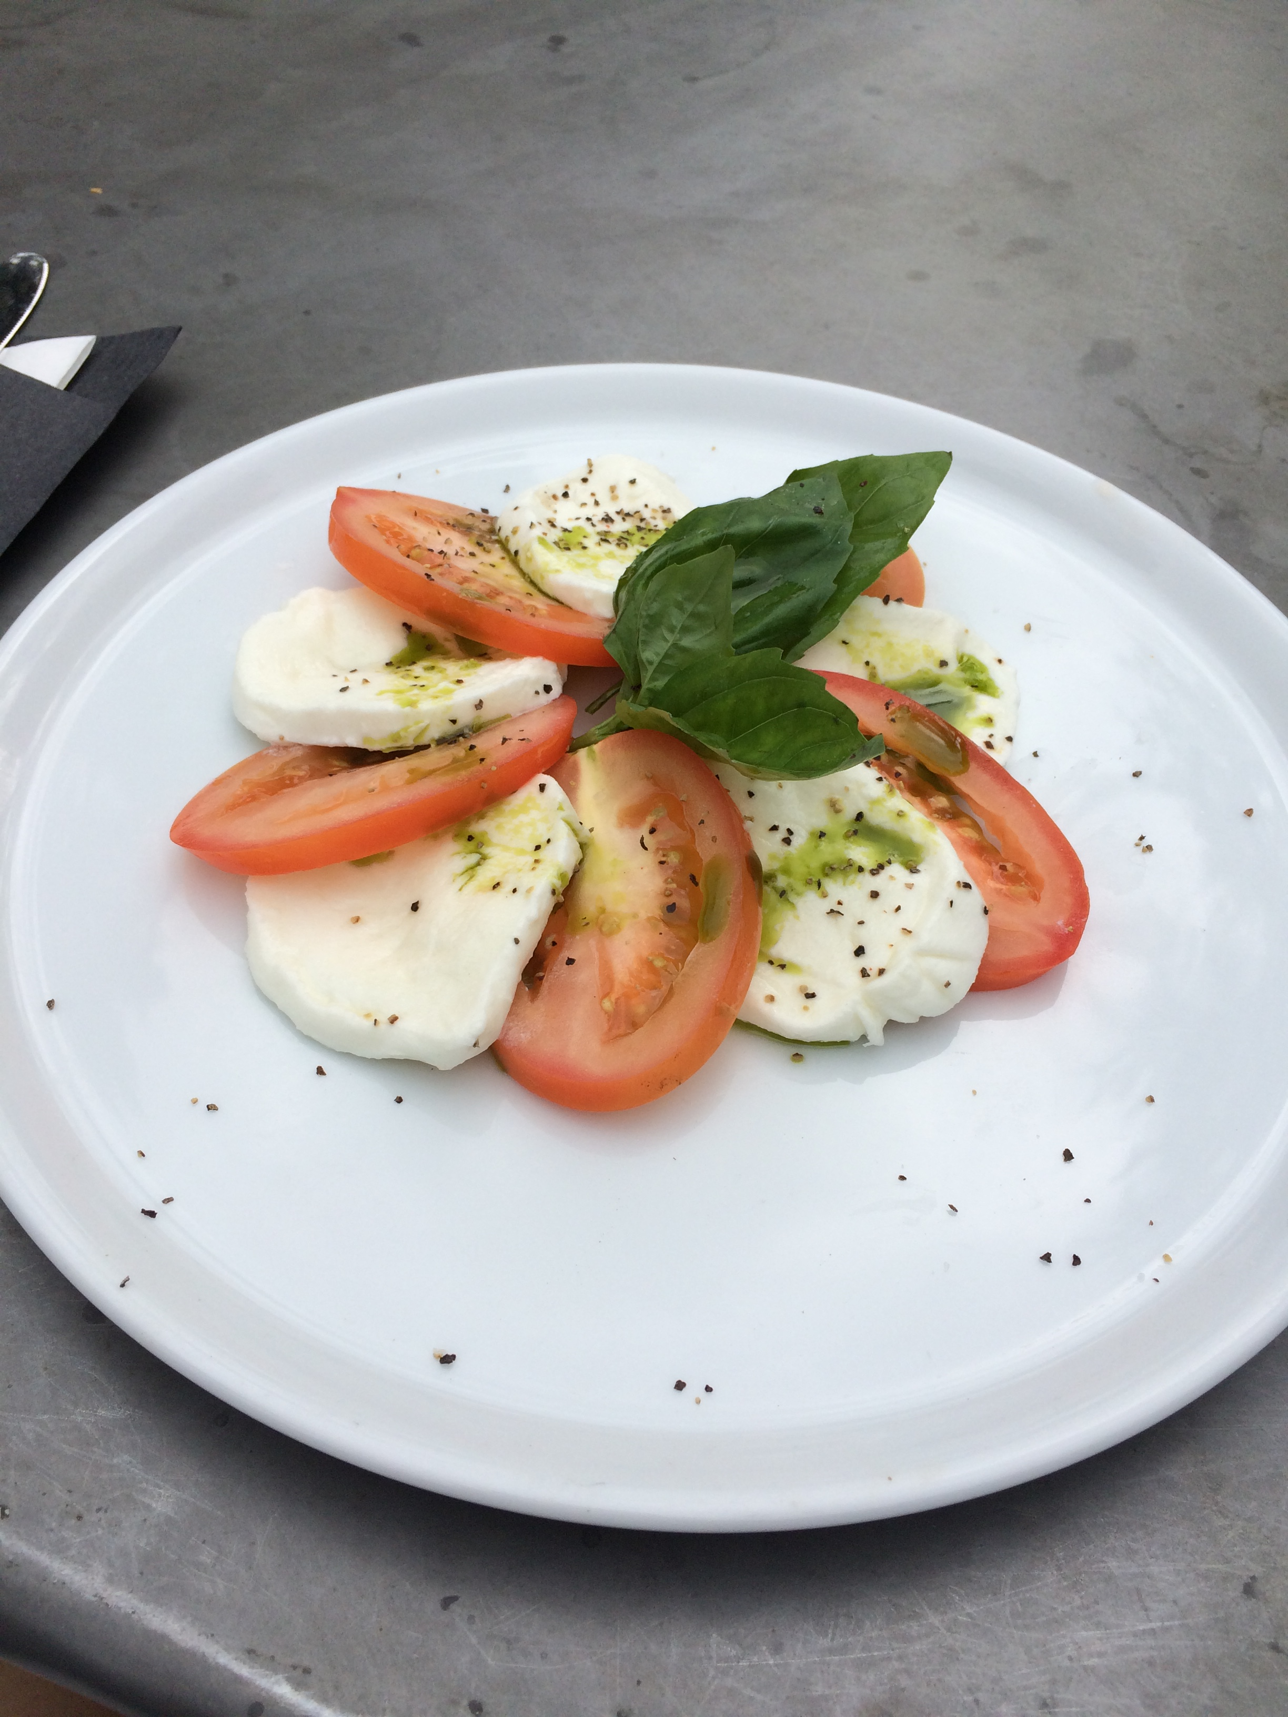
“FAST AND SLOW” SUSTAINABILITY A HUMAN EXPERIENCE "LESS IS MORE”

Slide 2
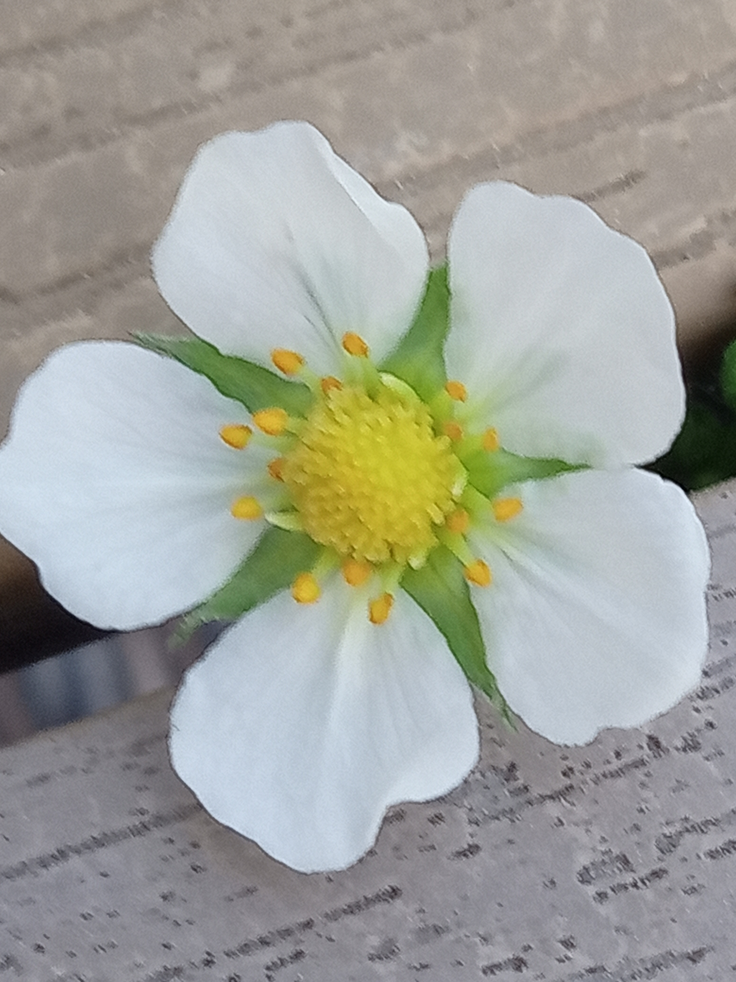
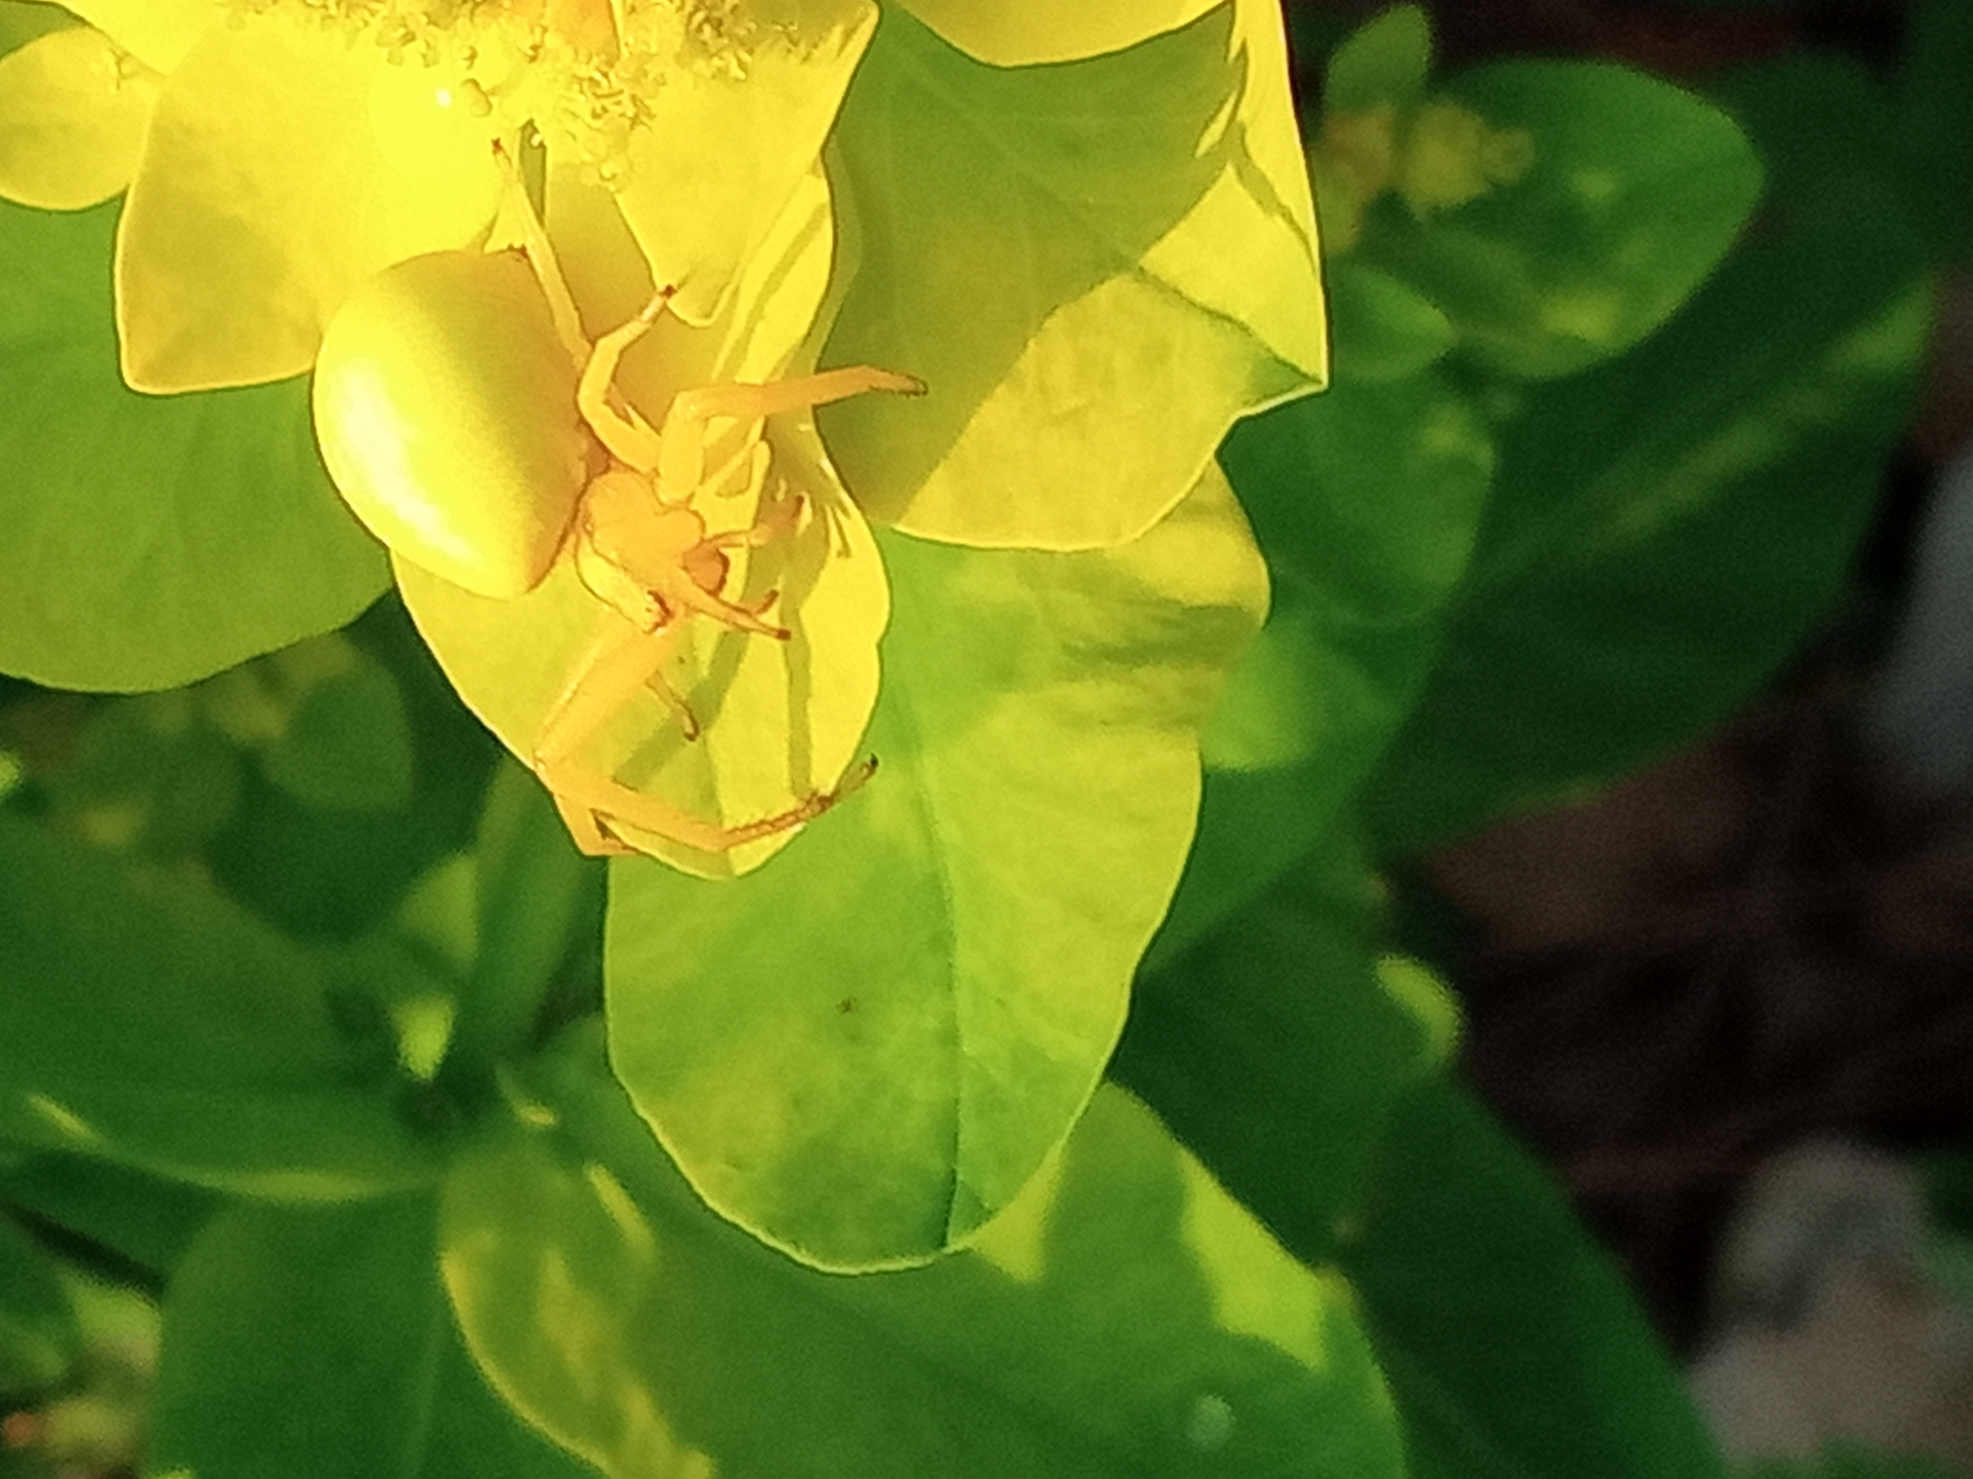
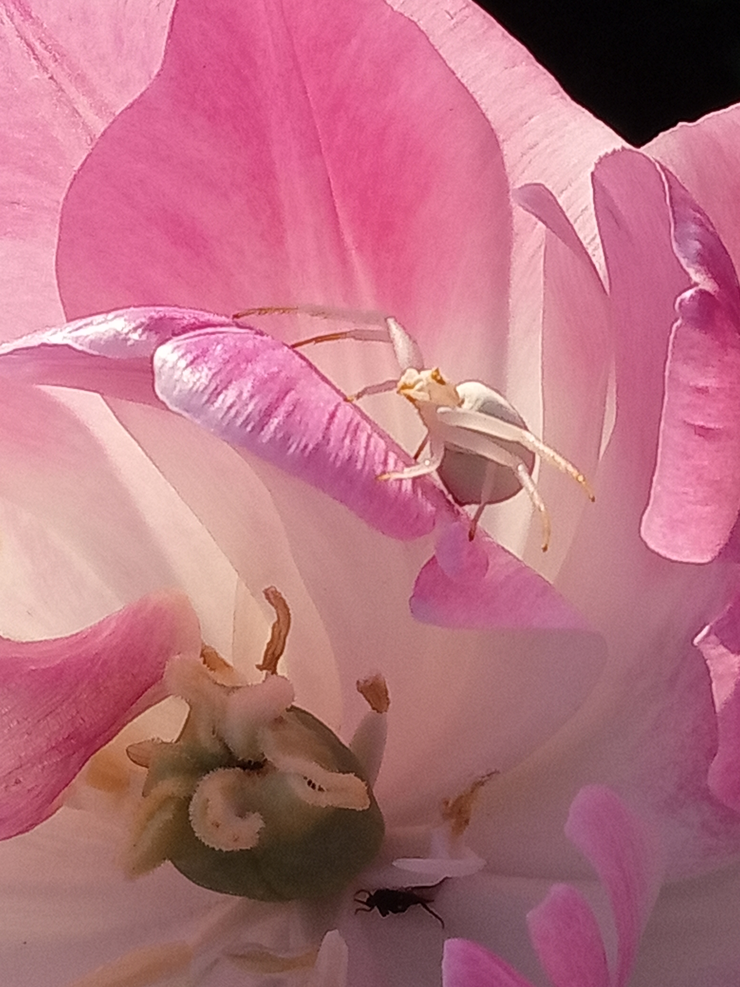
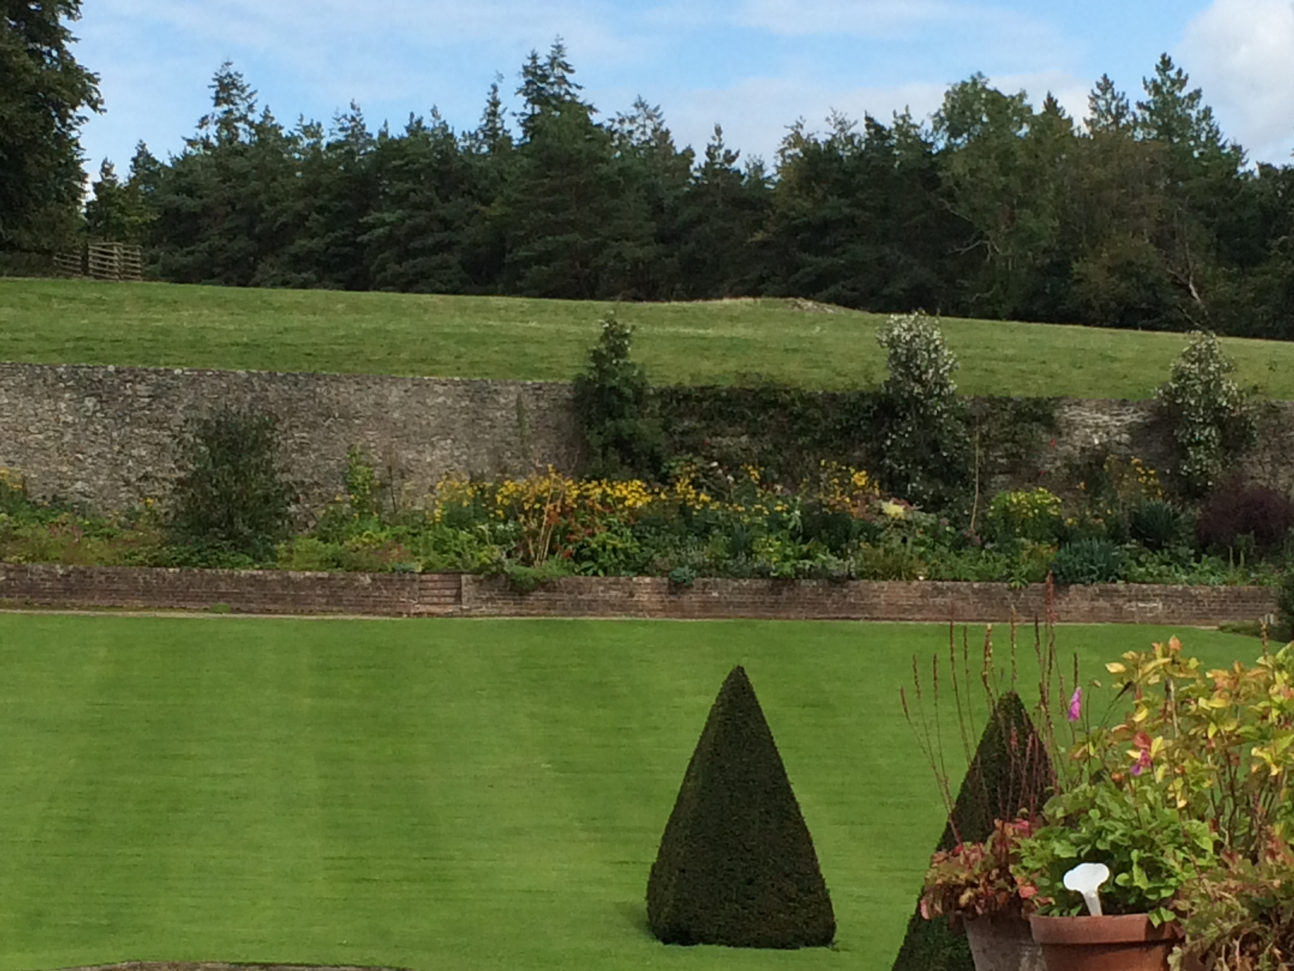
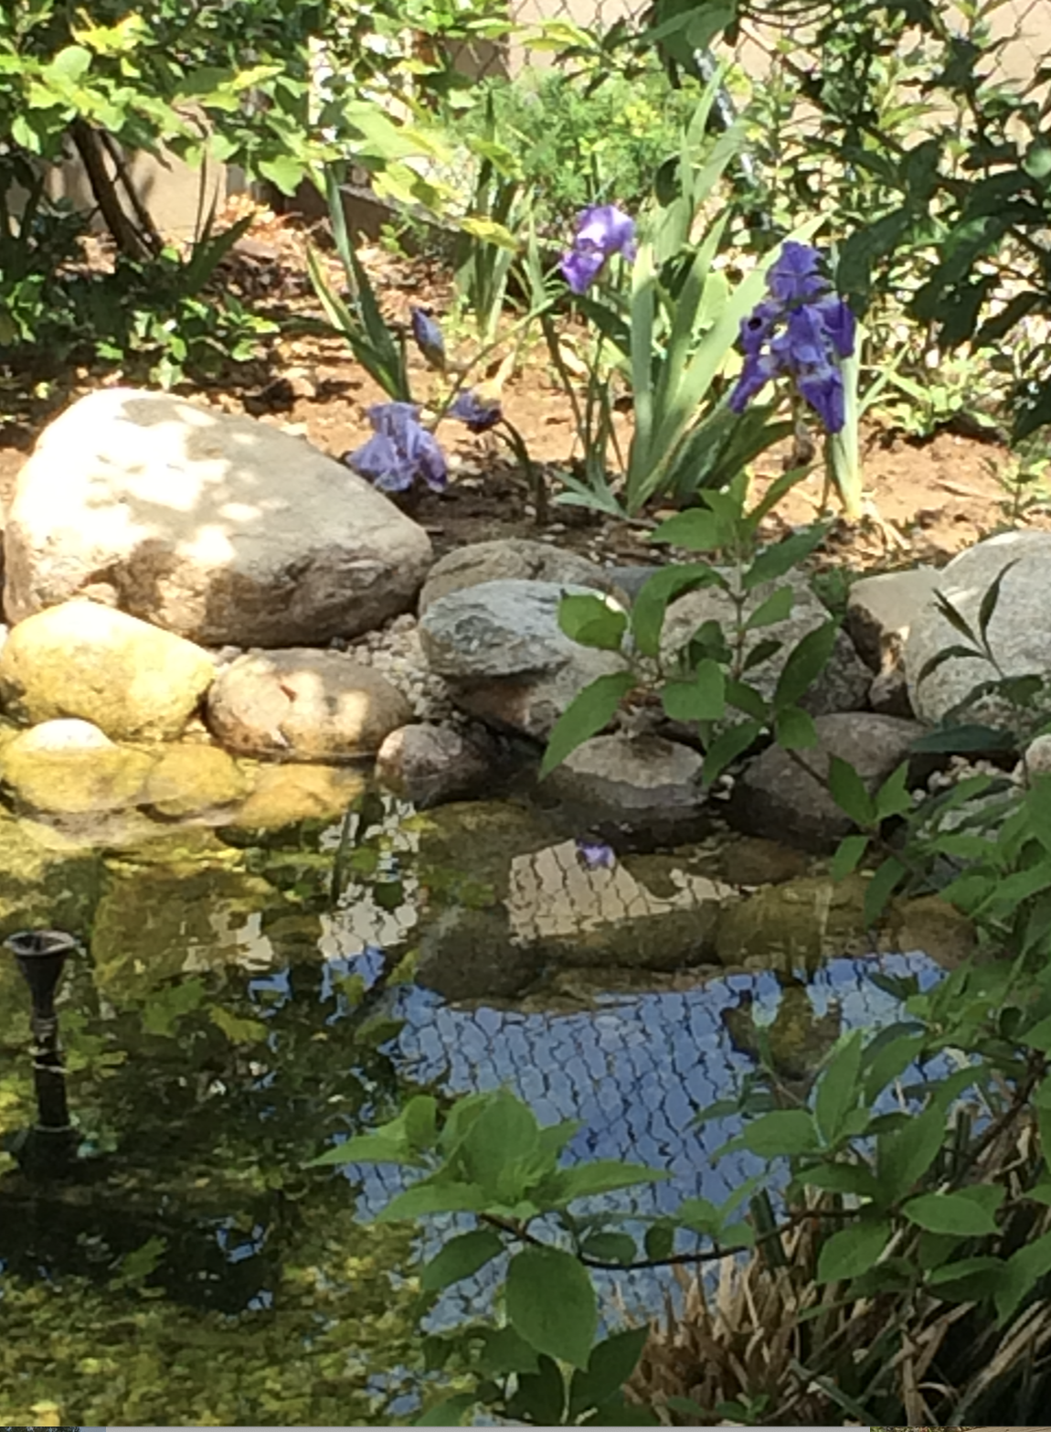
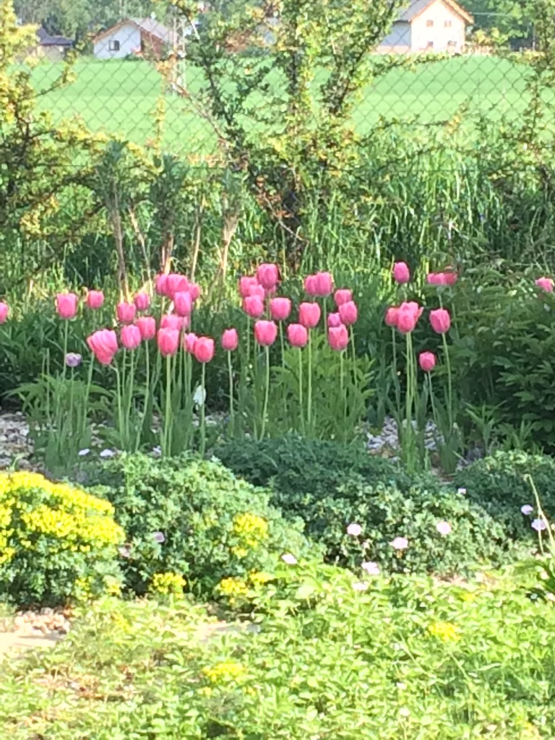
“A poor life this if, full of care, We have no time to stand and stare.”
William Henry Davies (1871-1940)

Slide 3
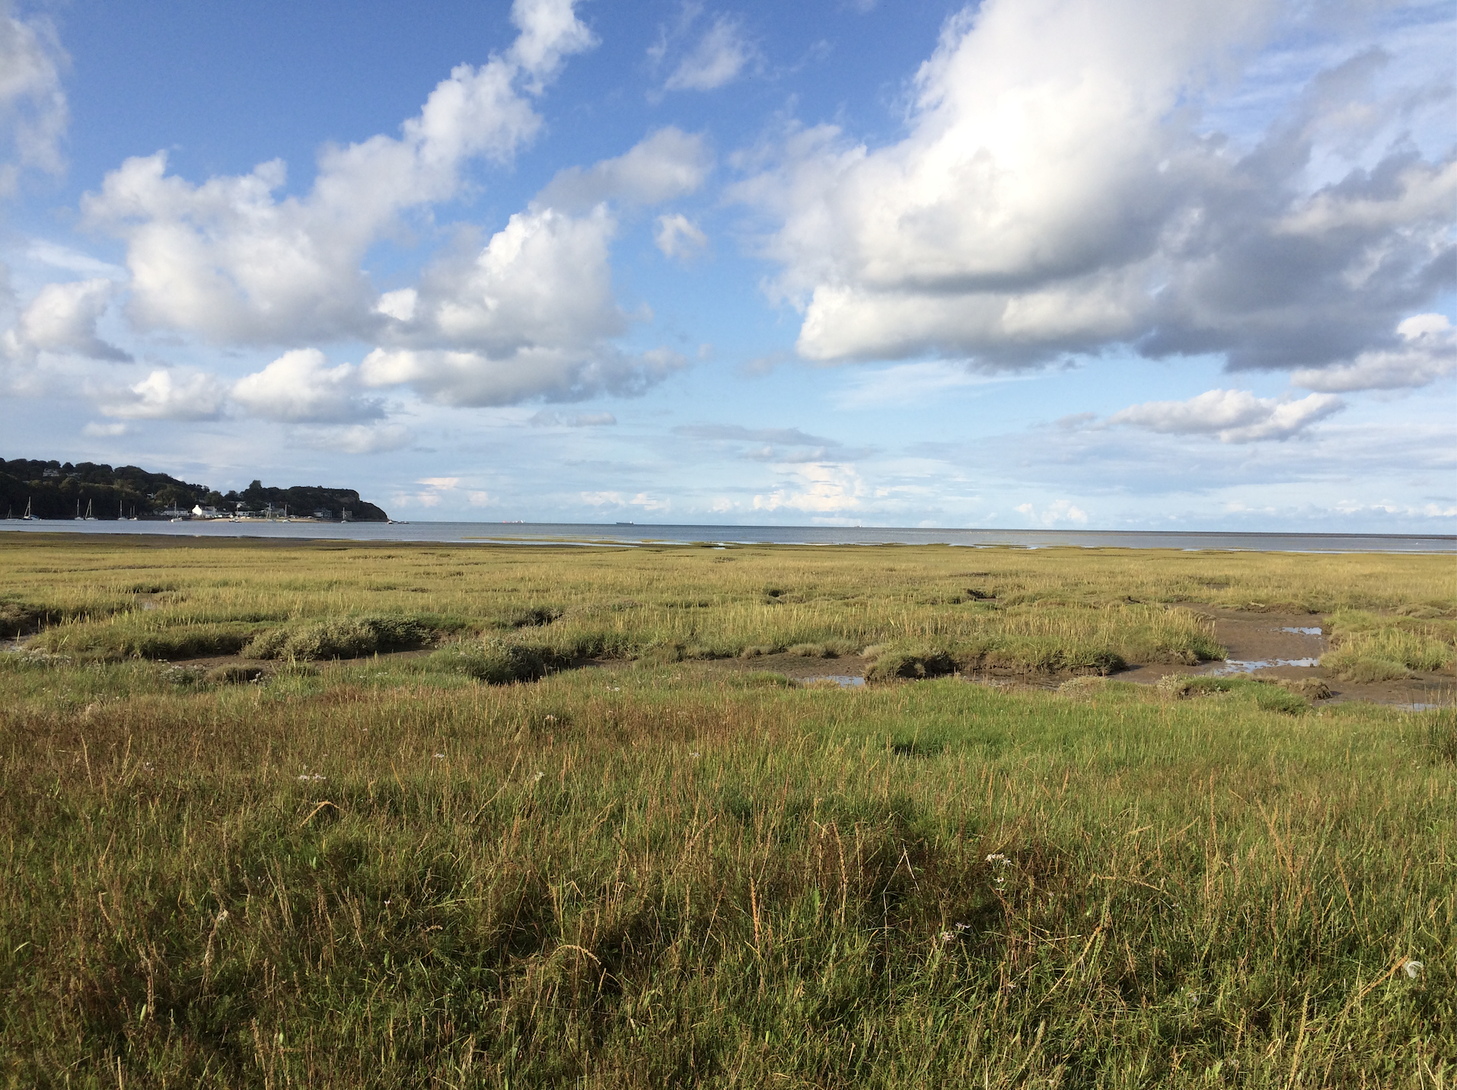
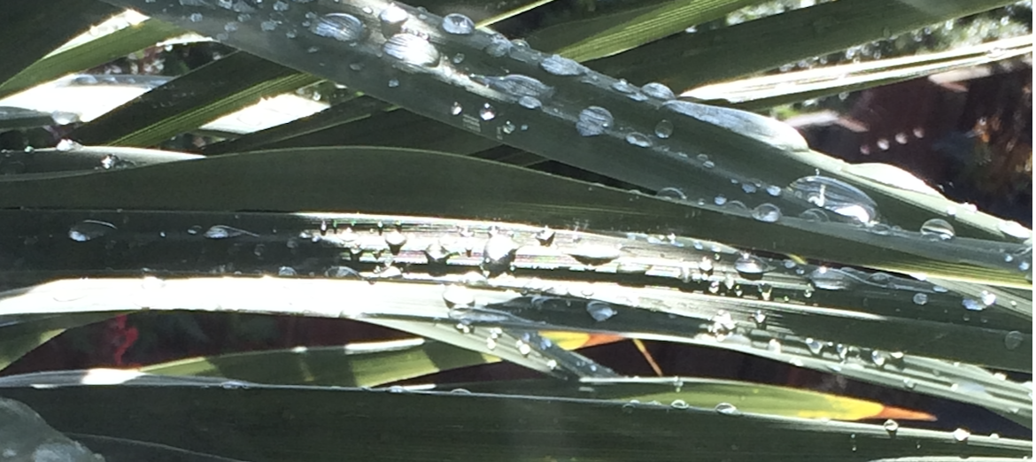
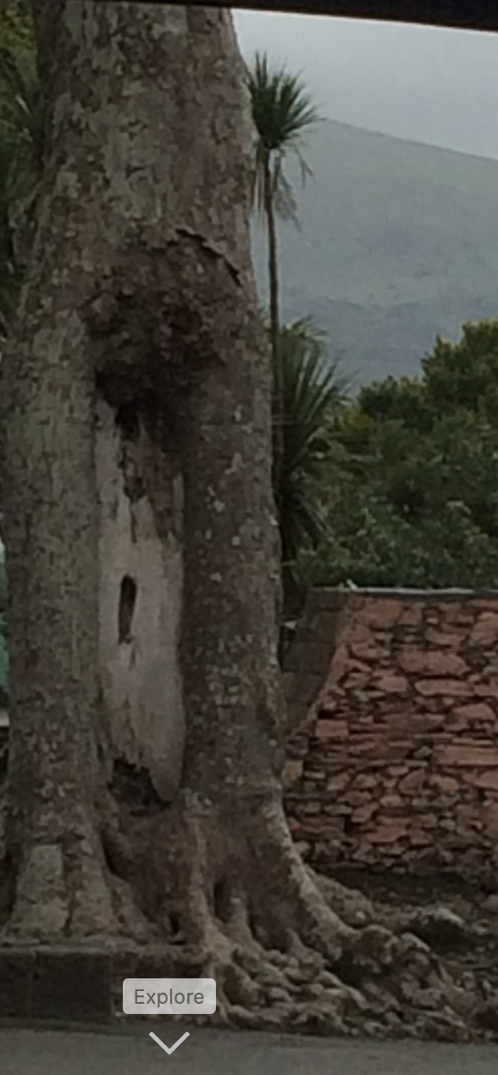
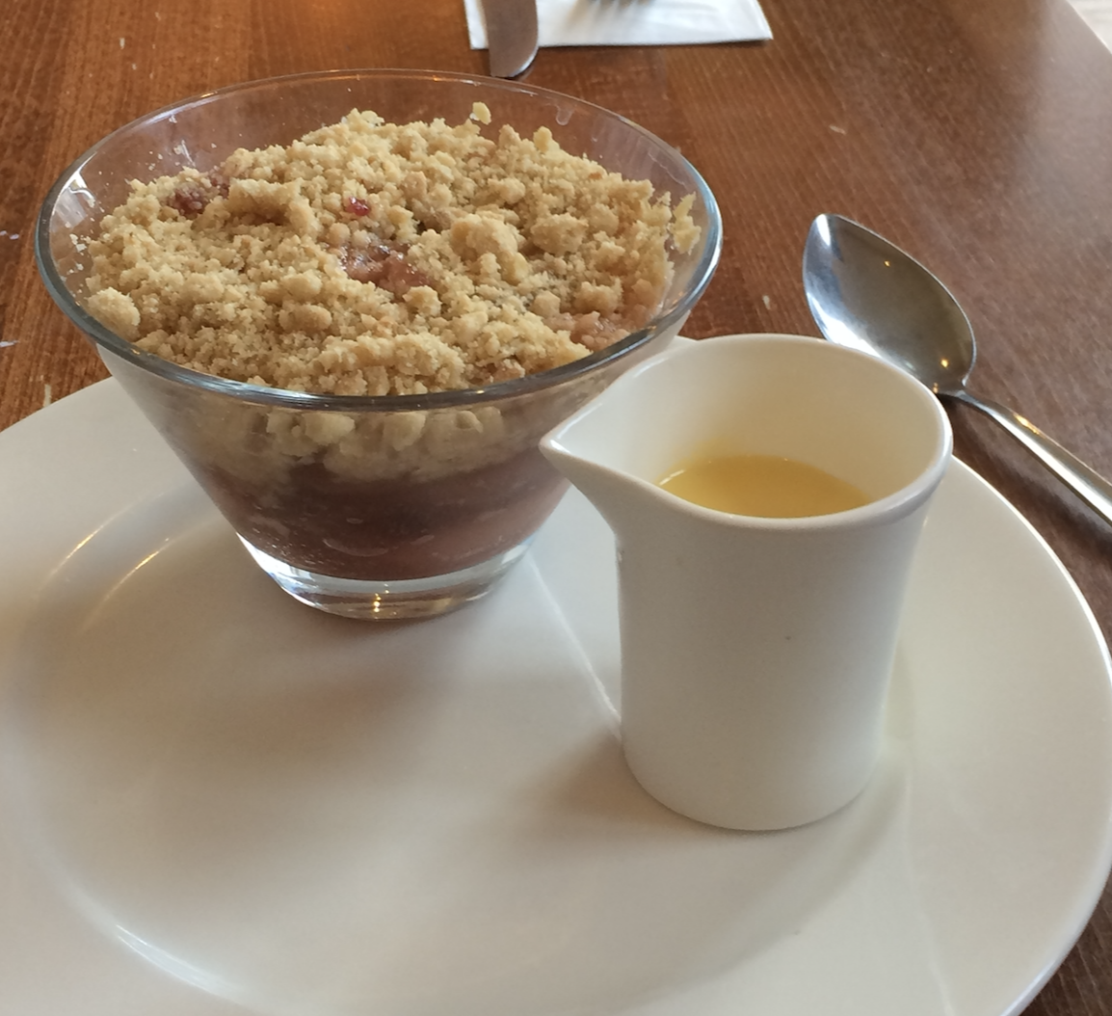
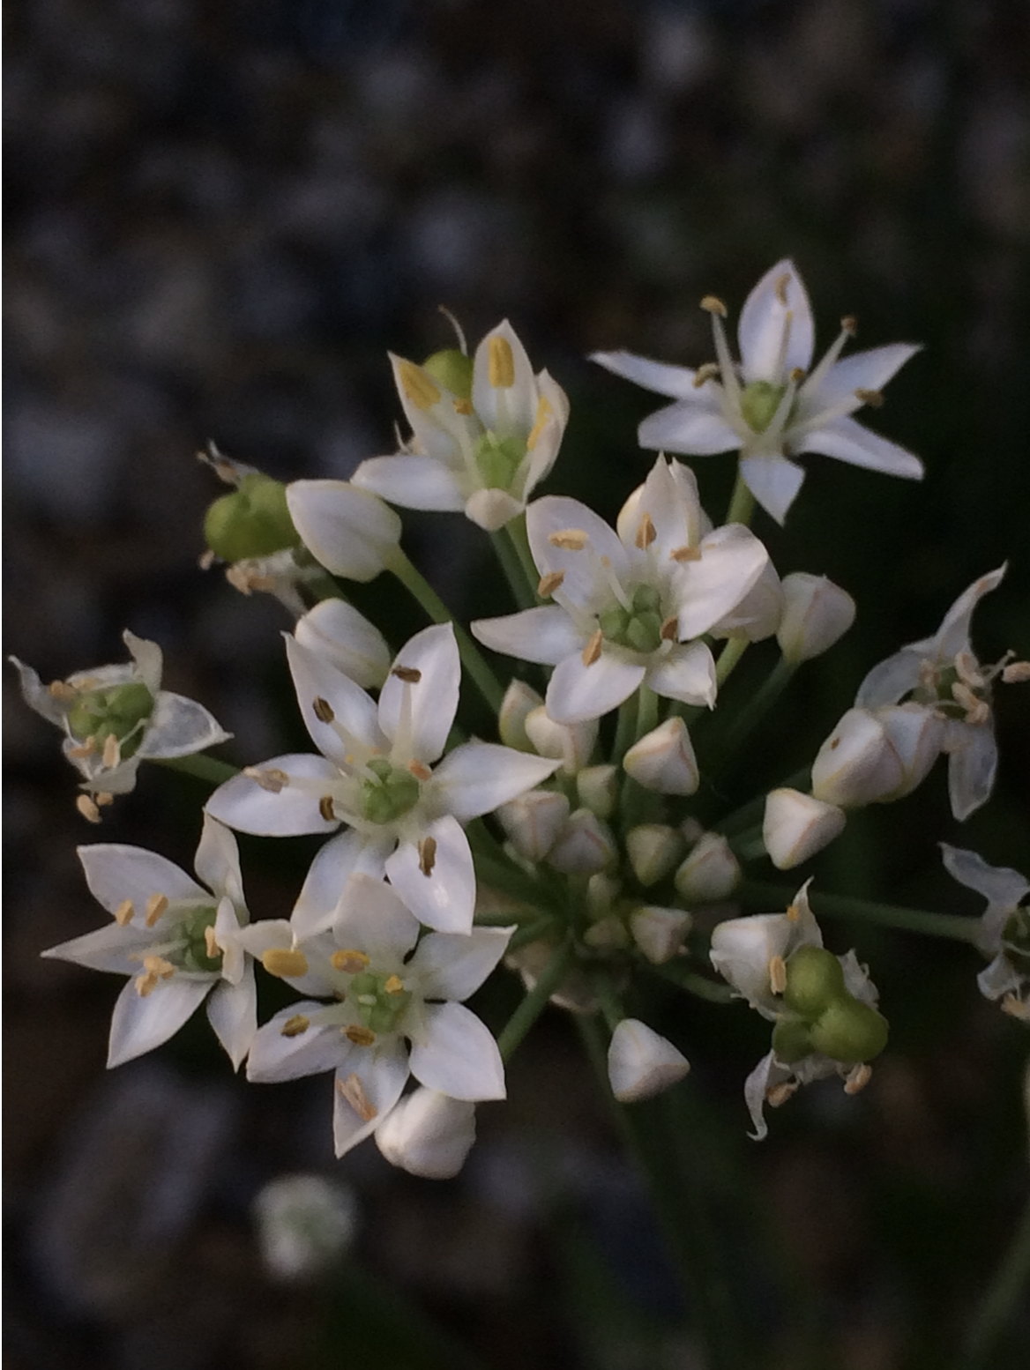

Slide 4
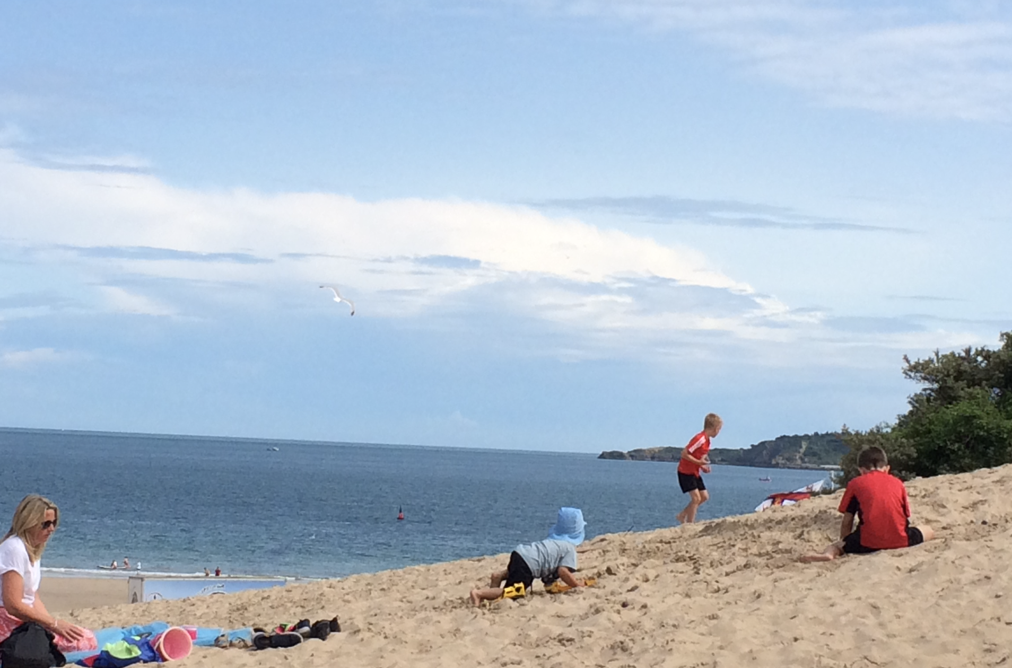
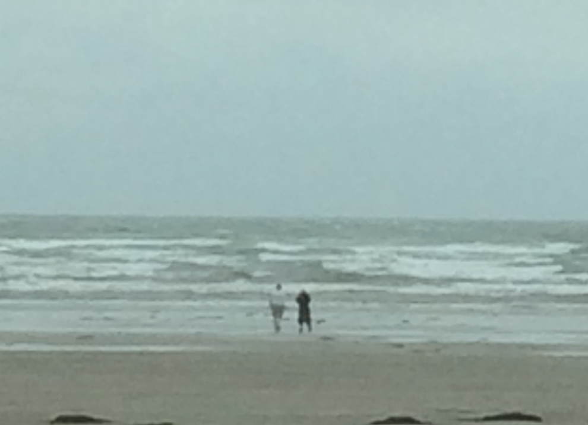
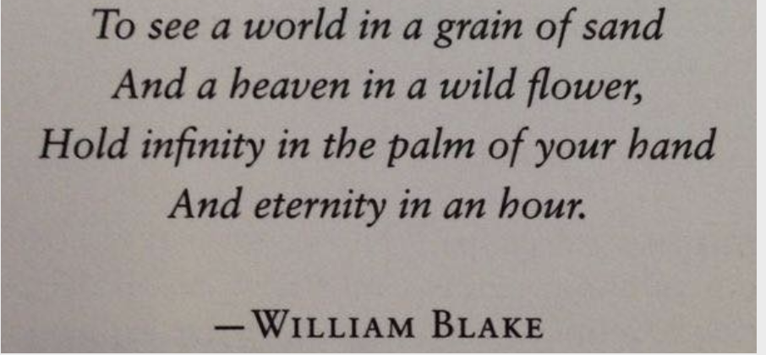
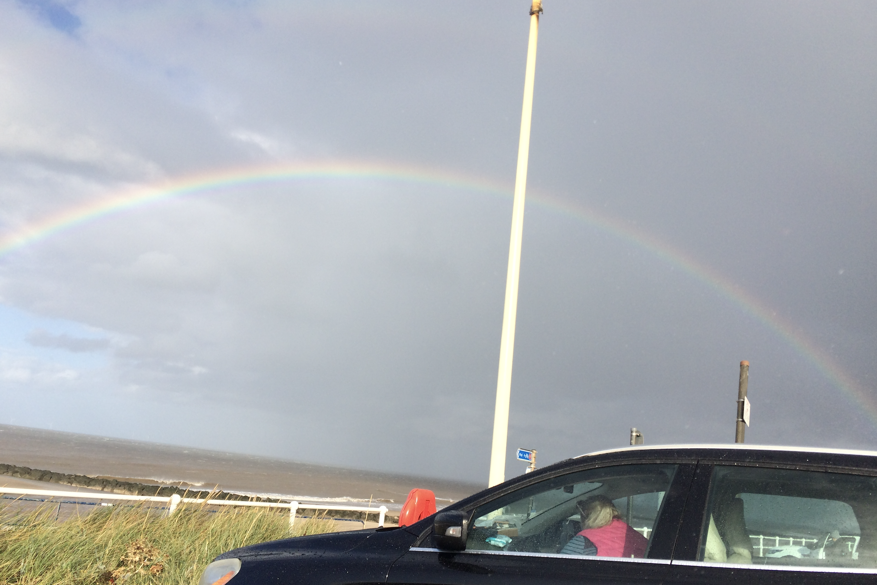
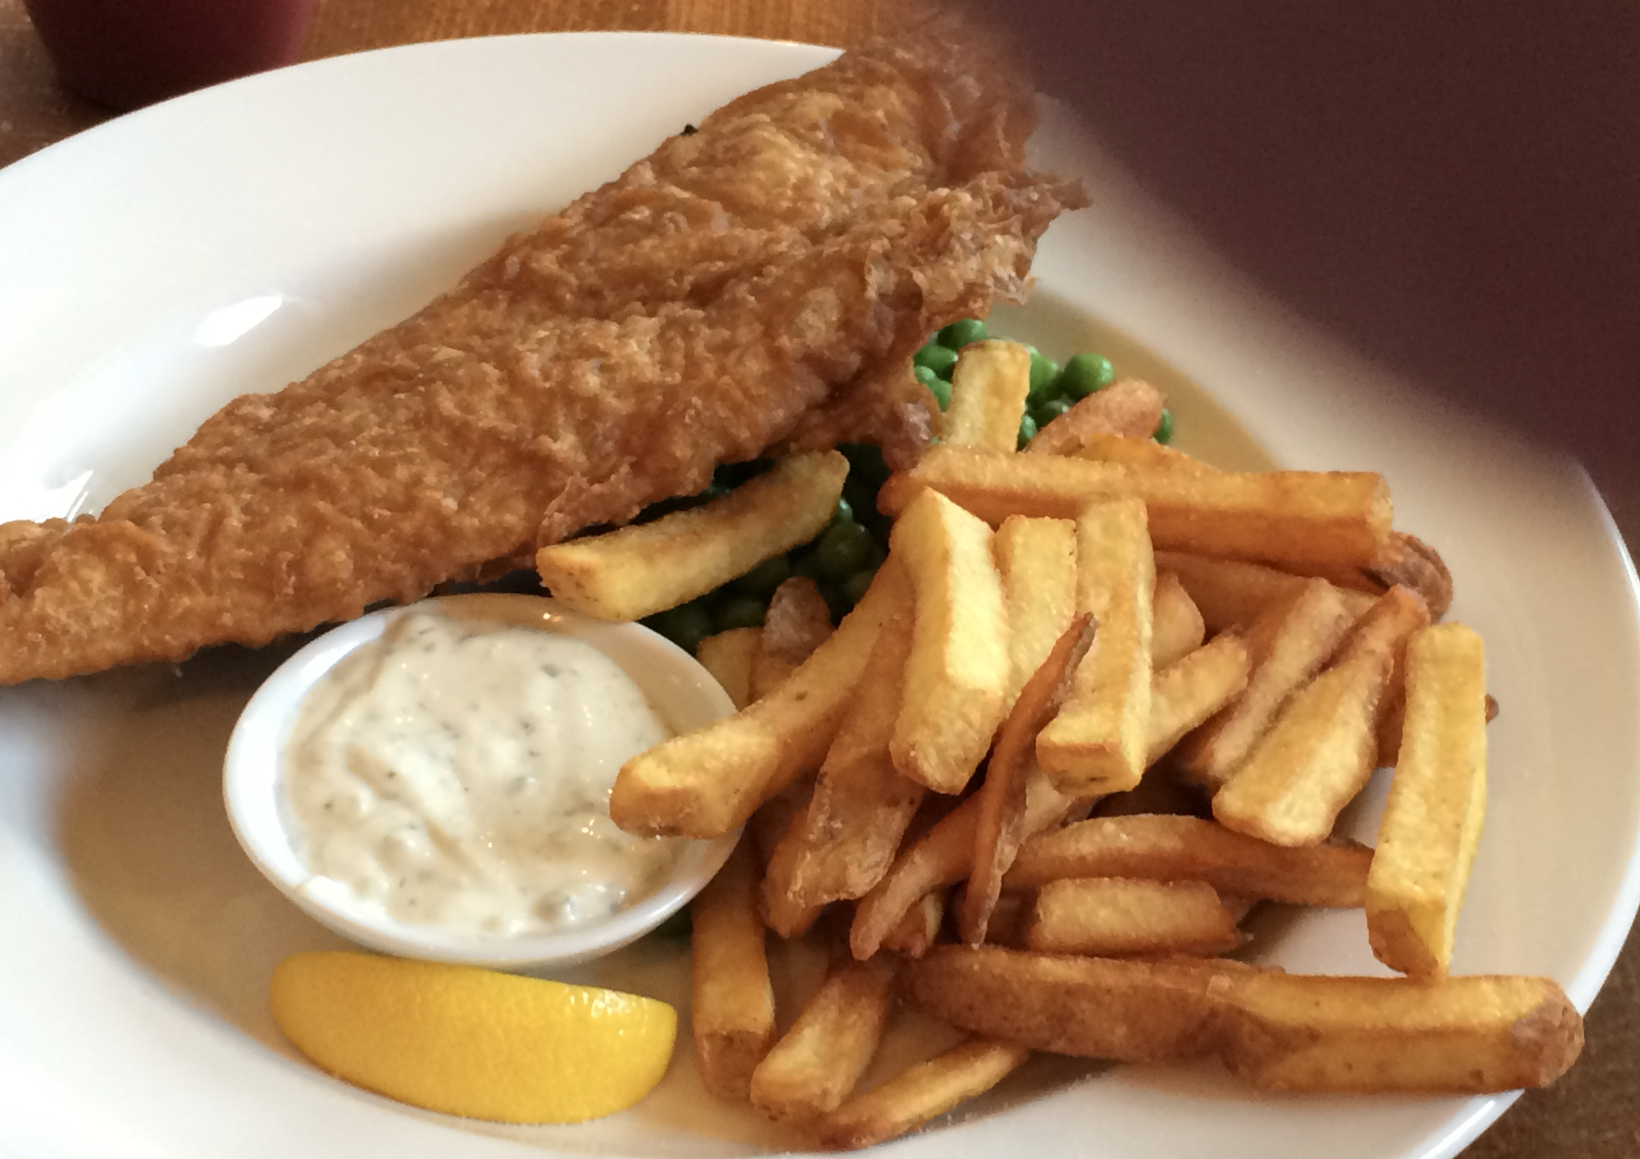

Slide 5
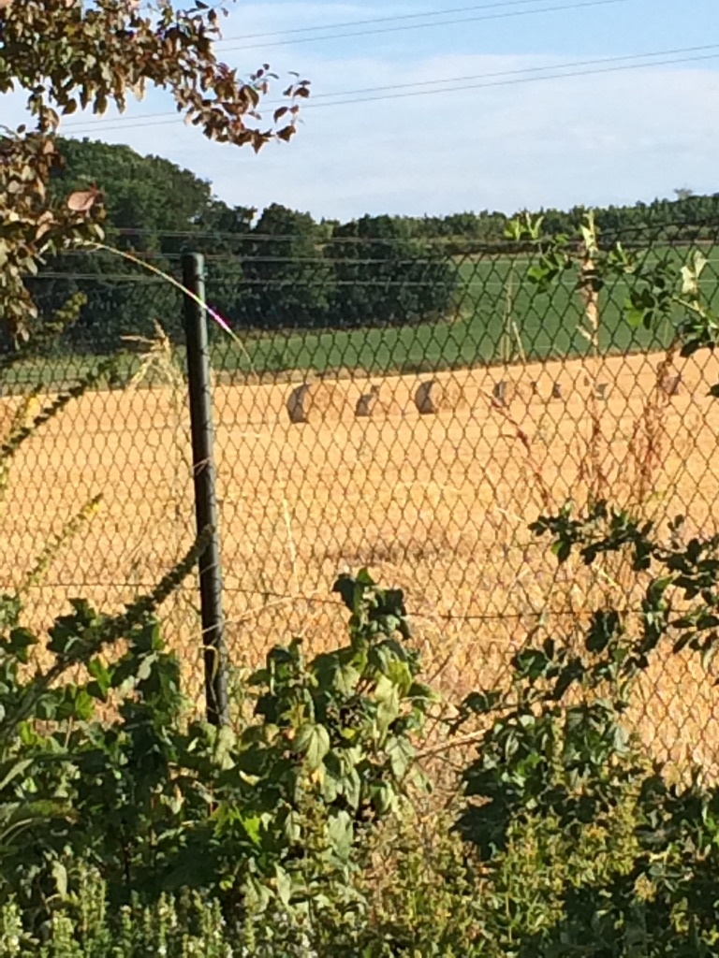
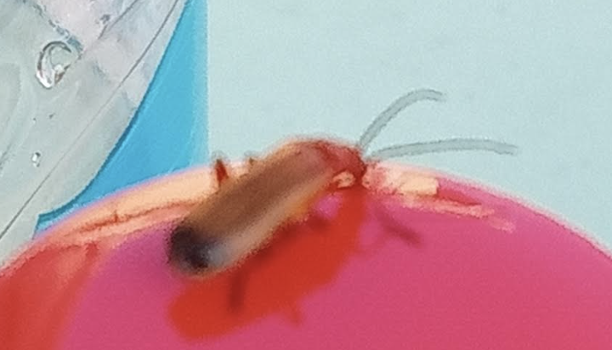
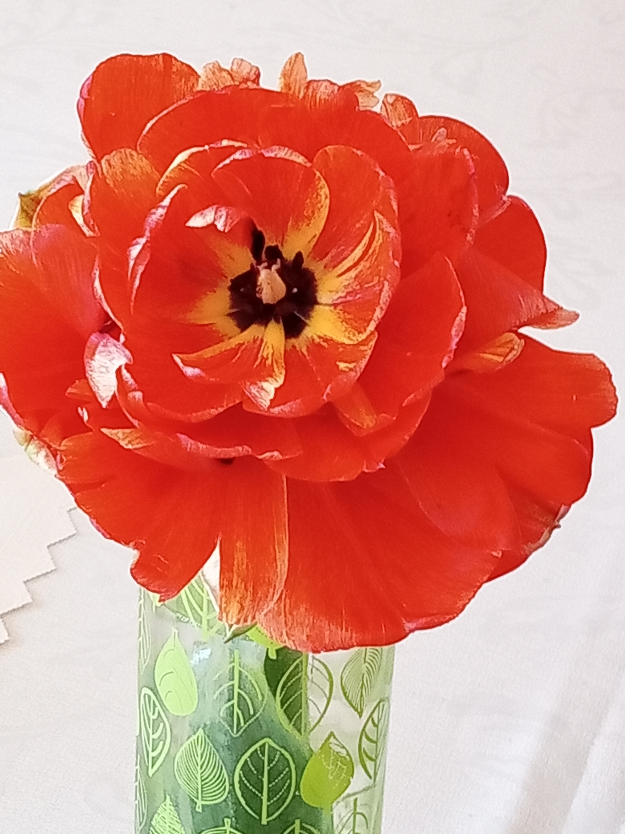
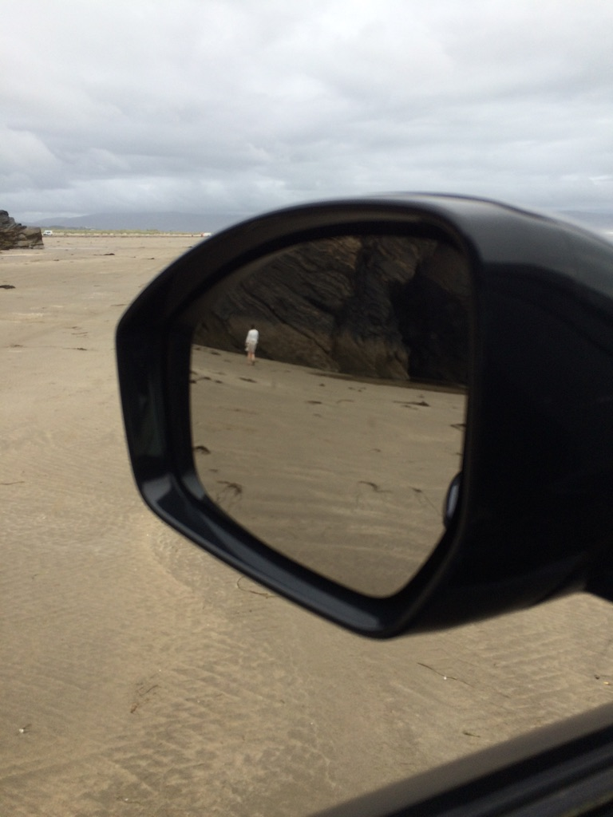
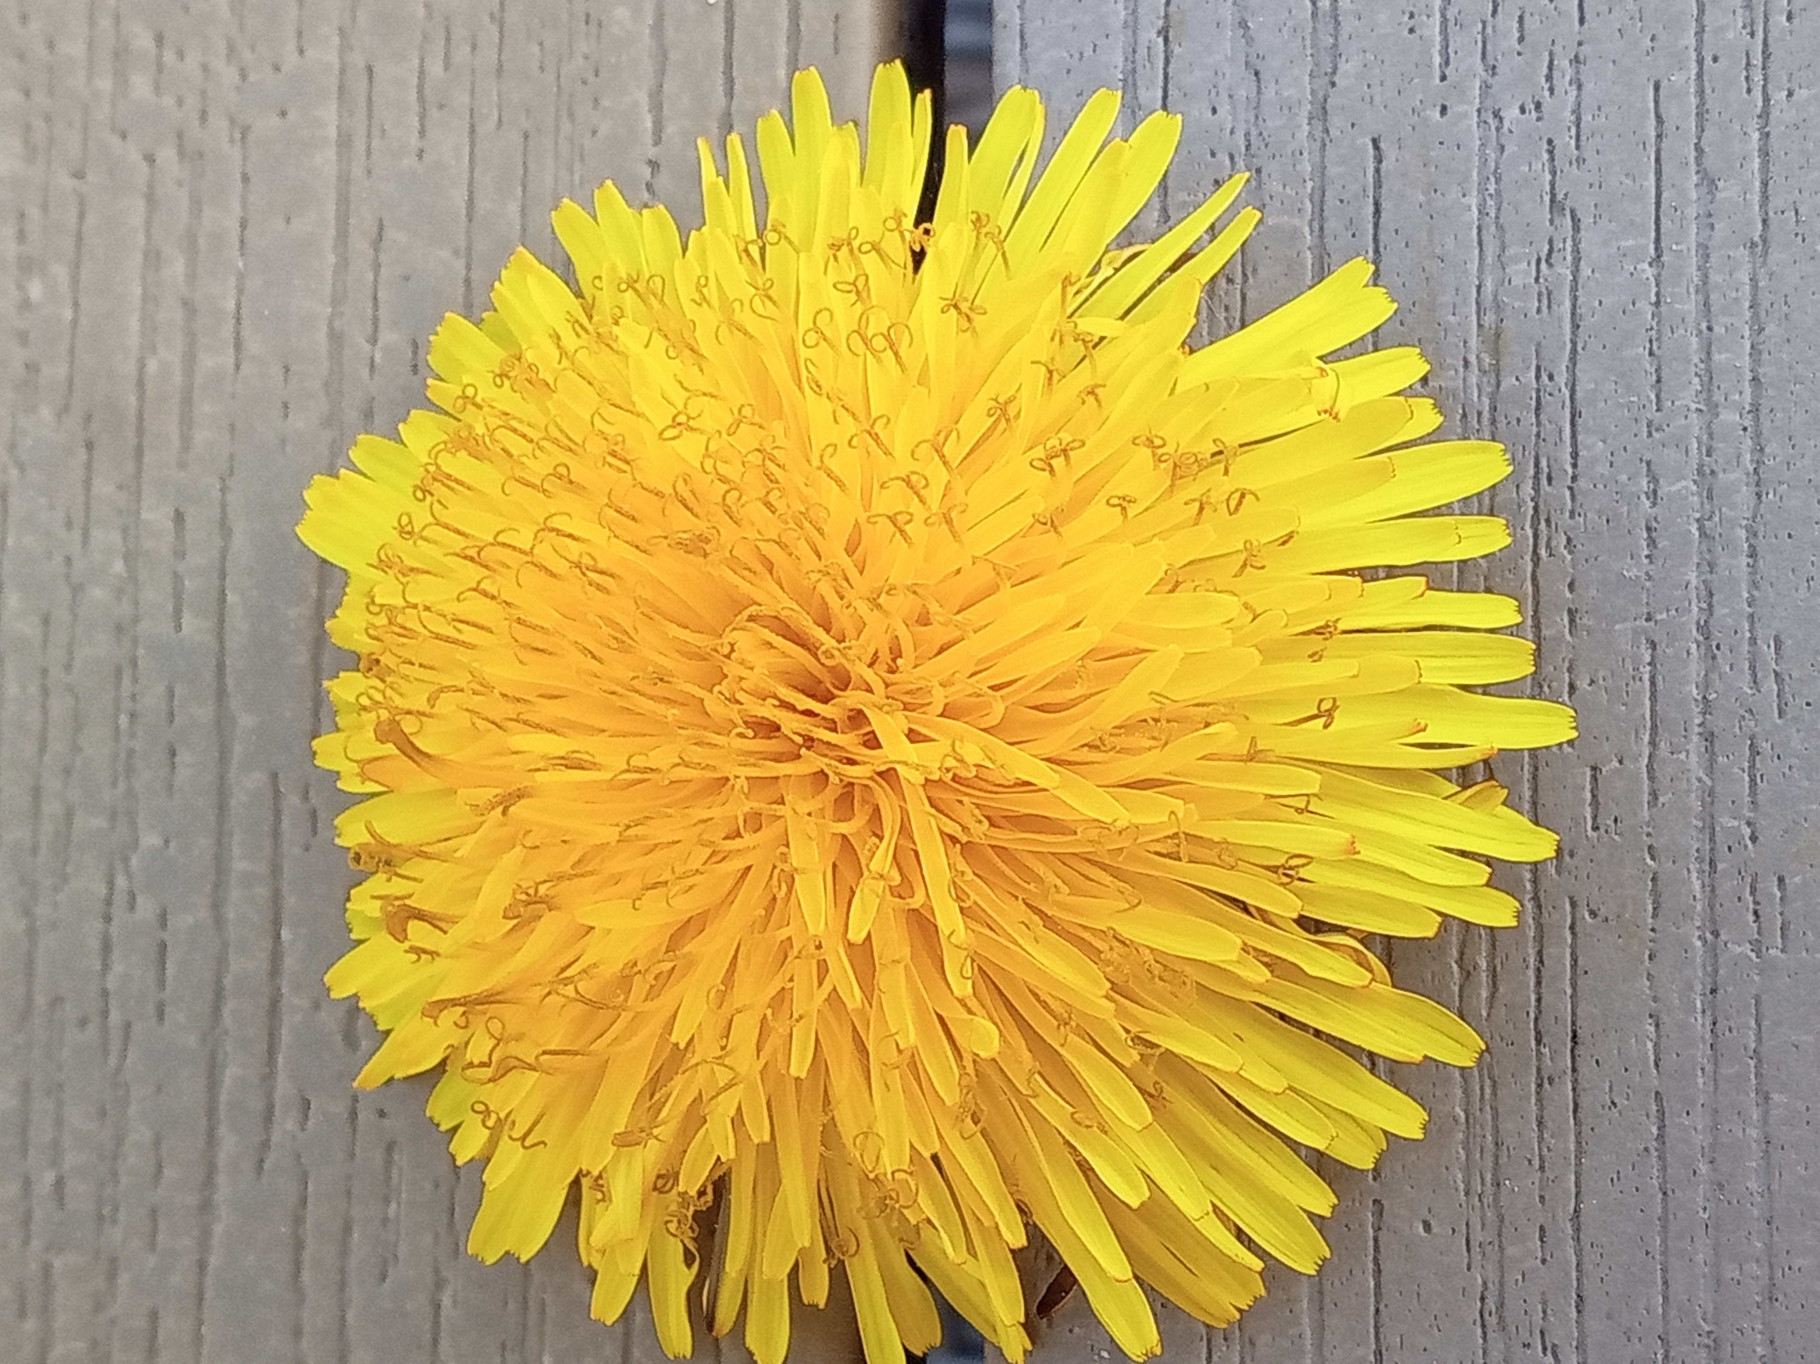
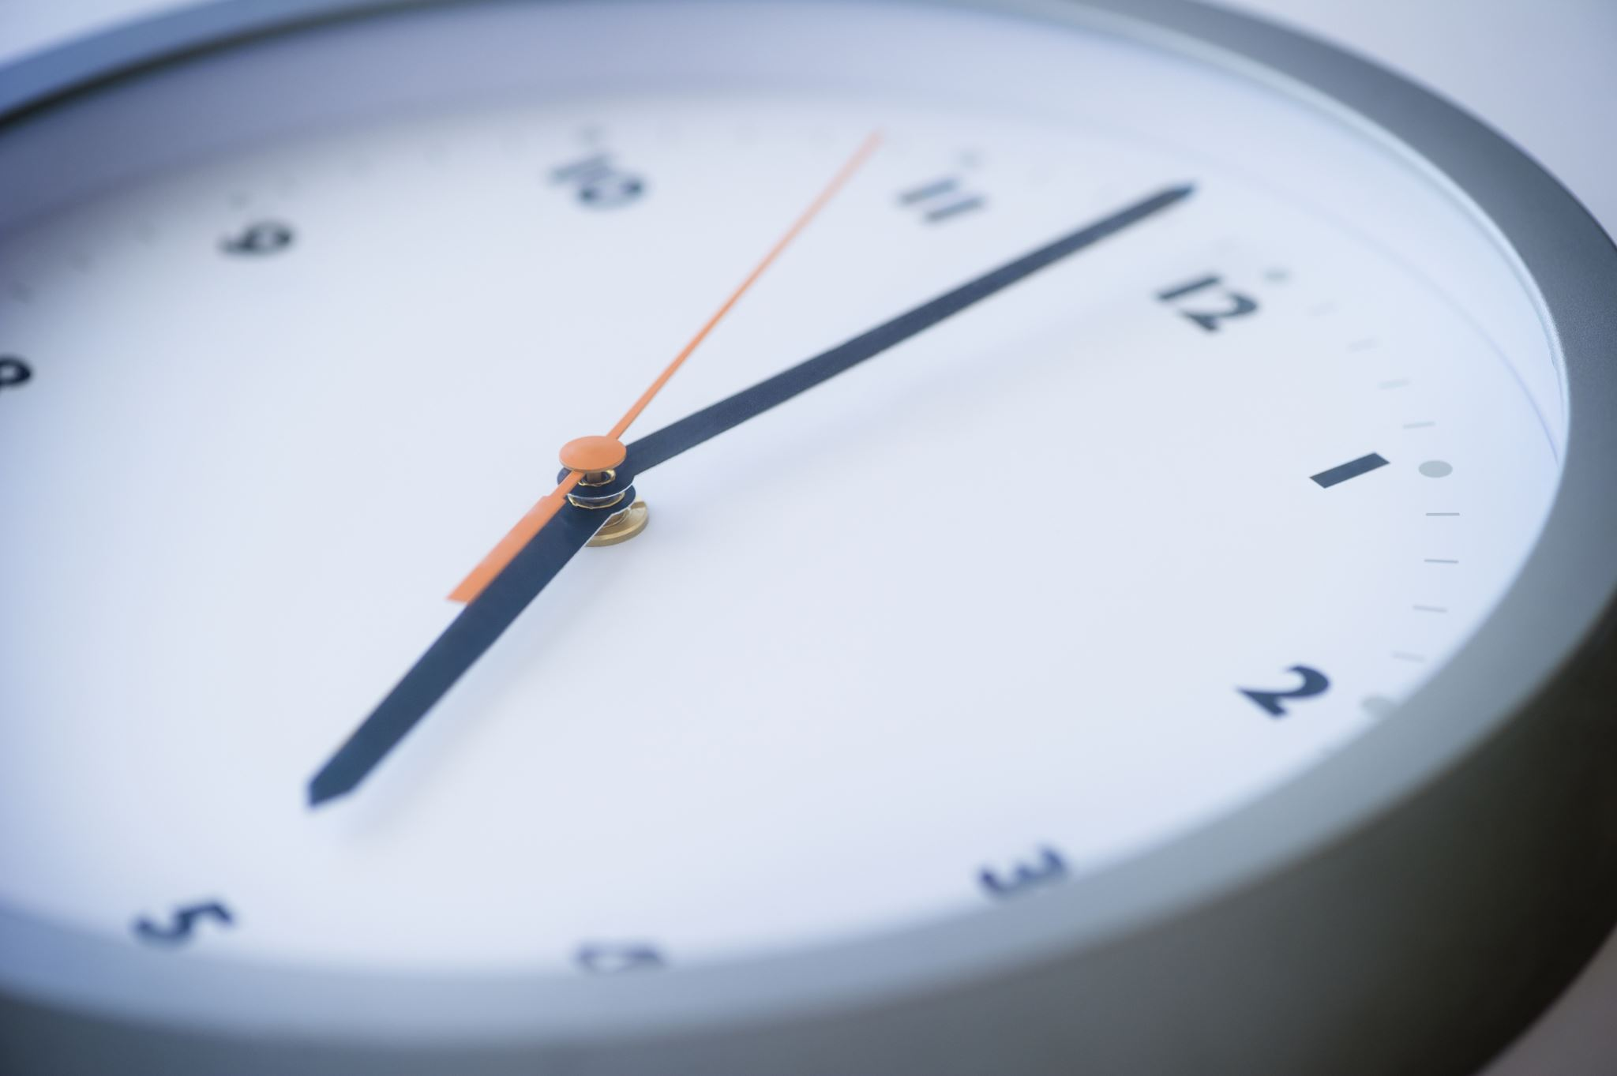
Retired? You have:
Grey hair? Time to share.
Time to stare and time to care.
Time to live and time to give .
Time to cook and time to look.
Time to choose what and when you eat.
Time to listen down by the sea.
Take a seat in the park whenever you’re free.
You are a product of Nature, it’s true.
Time to give back what’s possible for you
For we can never return all that is due.
Glynn Kirkham October 2023

Slide 6
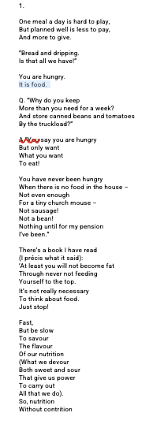
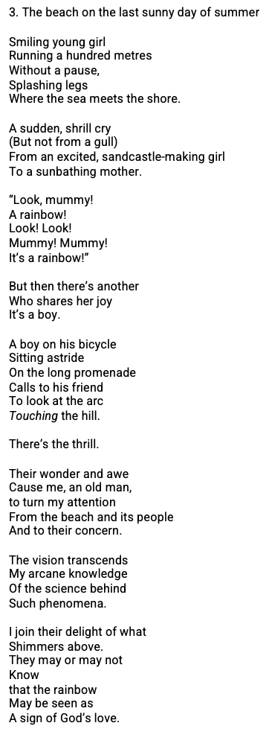
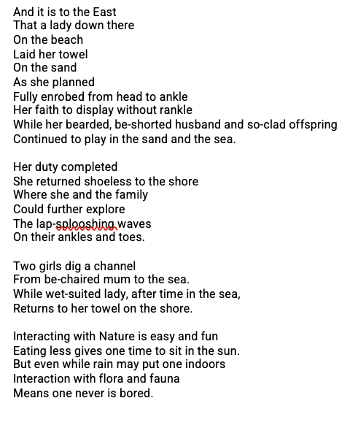
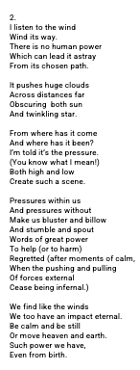
Verses to be read for ‘fast or slow’ “Nature is nurture” Glynn Kirkham September 2023
Feed for Need
Conform Breakfast
(Snack)
Lunch / Dinner
(Snack)
Dinner / Tea
(Supper)
Reform
Breakfast
(Tablets)
Dinner/Tea
Red Wine
Deform
Breakfast
(Tablets)
Red Wine
Warning
Talk to your doctor
before you diet!!!

Slide 7
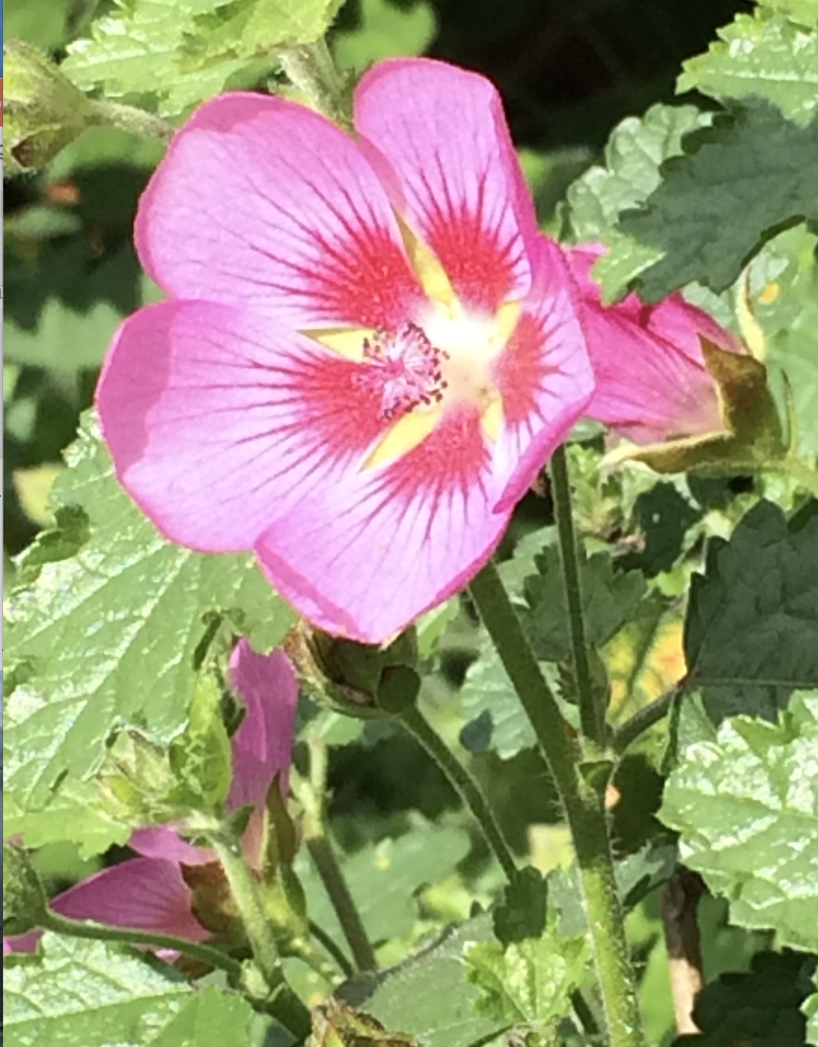
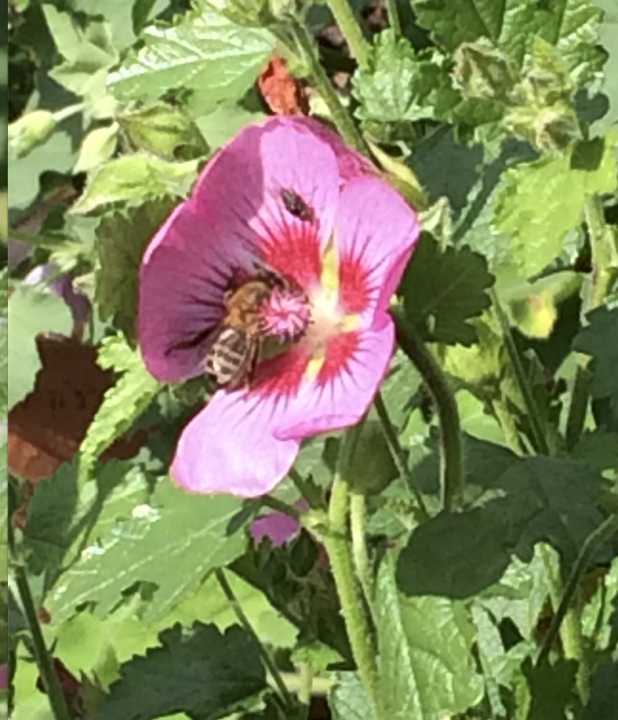
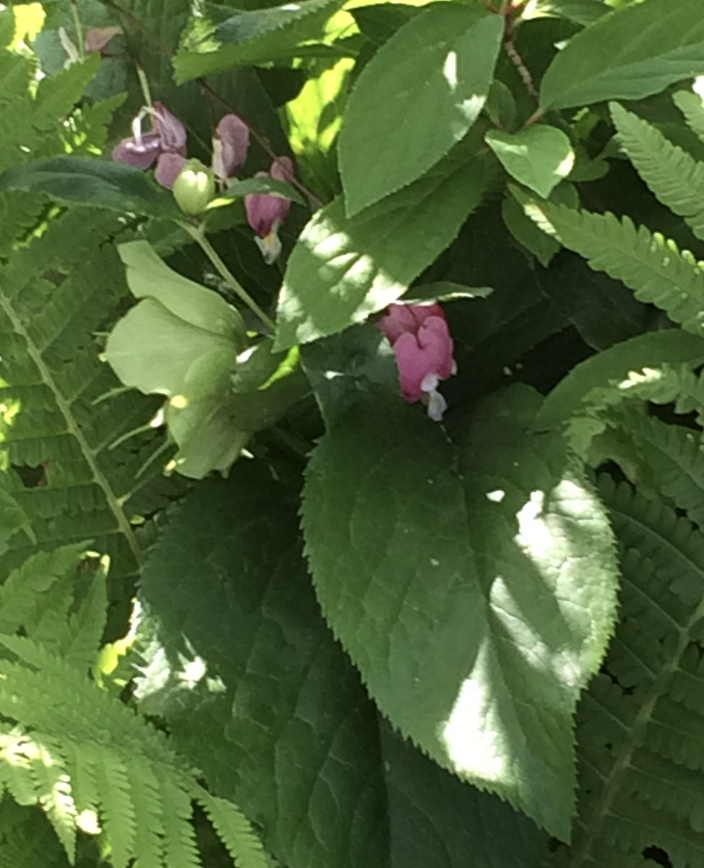

Slide 8
References
William Blake, “Auguries of Innocence”
https://www.poetryfoundation.org/poems/43650/auguries-of-innocence
William Henry Davies (1871-1940) “Leisure” https://www.yourdailypoem.com/listpoem.jsp?poem_id=100#:~:text=Leisure%20by%20William%20Henry%20Davies%20%2D%20Your%20Daily%20Poem&text=What%20is%20this%20life%20if,time%20to%20stand%20and%20stare.&text=And%20stare%20as%20long%20as%20sheep%20or%20cows
‘Just one thing with MichaeL Morley\, “Choose red wine” broadcast Wed. 23rd Aug 2023 20:45 BBC RADIO 4
https://www.bbc.co.uk/programmes/m001hp70
M. Victoria Moreno-Arribas,^{1,*} Begoña Bartolomé,¹ José L. Peñalvo,² Patricia Pérez-Matute,³ and Maria José Motilva⁴ “Relationship between Wine Consumption, Diet and Microbiome Modulation in Alzheimer’s Disease” Nutrients. 2020 Oct; 12(10): 3082. PMCID: PMC7600228 PMID: 33050383 Published online 2020 Oct 10. doi: 10.3390/nu12103082
https://www.ncbi.nlm.nih.gov/pmc/articles/PMC7600228/
Queipo-Ortuño María Isabel, Boto-Ordóñez María, Murri Mora, Gomez-Zumaquero Juan Miguel, Clemente-Postigo Mercedes, Estruch Ramon, Cardona Diaz Fernando, Andrés-Lacueva Cristina, Tinahones Francisco J (2012)“Influence of red wine polyphenols and ethanol on the gut microbiota ecology and biochemical biomarkers”, The American Journal of Clinical Nutrition, Volume 95, Issue 6, June 2012, Pages 1323-1334 https://www.sciencedirect.com/science/article/pii/S0002916523028150

Slide 9
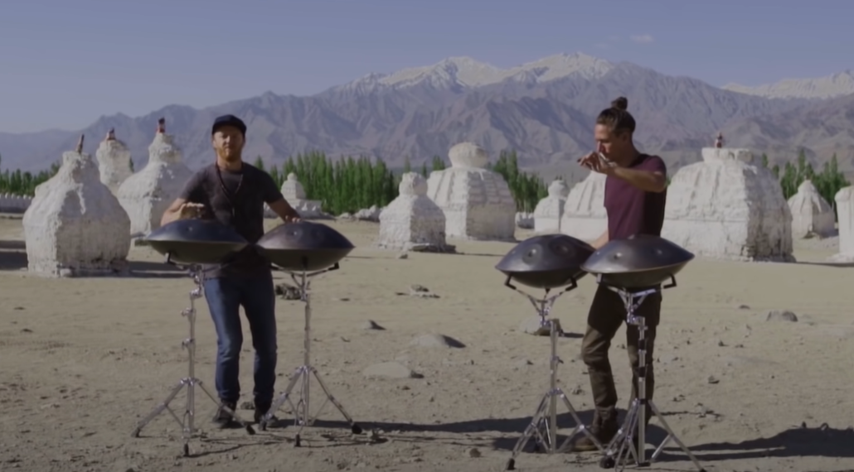
You have been listening to Hang Massive performing The Secret Kissing of the Sun and Moon

