Slide 1
​Towards a Better Understanding
of Our Own Learning Lives
Connecting people who value the idea of lifewide learning who care about the learning of others
Developing a culture that is trusting, respectful and appreciative
A process that facilitates inquiry and the means to share and grow knowledge
The means to curate and share knowledge beyond the enterprise so that others might benefit

Slide 2
We advocate, encourage and support lifewide and ecological approaches to learning, development, creativity and education﻿
Personal - why am I participating in this inquiry?
Educational - how might we apply our learning in educational or work settings?
Social – how can we share the knowledge we develop more widely?
Political – how can the insights we develop be used to persuade policy makers to value a lifewide perspective

Slide 3
Lifewide Learning Research & Development Group –
Protected space for interaction, discussion, sharing & learning
WEEK -3 to 1
1 Finding &
connecting people
2 Production of
information &
infrastructure
3 First Meeting
overview/discussion
4 Experiential
domains maps
5 Initiation of process
WEEKS 1 – 5
Paying more attention to how learning emerges in the different parts of our life noting anything interesting or particularly meaningful
Creating five vignettes of our learning experiences drawing out interesting insights into the circumstances in which learning emerged and what it meant.
3 Sharing vignettes in the LinkedIn discussion space and commenting on the experiences of other participants
WEEK 6
1 Final Meeting
to share our
experiences
and insights
2 Planing how we might curate and distribute the knowledge we have gained

Slide 4
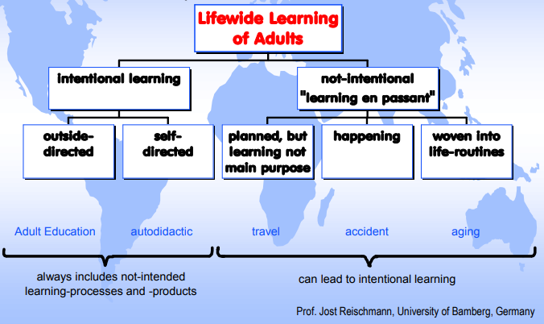
“The whole of life is learning therefore education can have no ending.”
Eduard Lindeman (& John Dewey)
To make aware….the whole life embracing understanding of the learning of adults I will use the expression “lifewide learning”:
Jost Reischmann (1986)

Slide 5
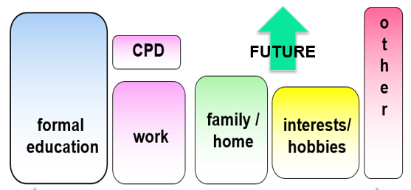
Creating meaning everyday
across the whole of our lives
Now, All, Personal & Significant – foundation for further lifelong learning
ANYTHING, ANYTIME, ANYWHERE, ANYHOW, FOR ANY PURPOSE
Formal / non-formal
Abstract
Need
Planned
Extrinsic Motivation
Cognitive
Directed
Individual/personal
Informal
Contextual
Interest
Emergent
Intrinsic Motivation
Emotional
Self-directed
Social/collaborative
INTEGRATE
THROUGH
EXPERIENCE

Slide 6
Enactivism - cognition arises through a dynamic interaction between
a person and their environment
Learning emerges as a person purposefully interacts with their environment
Commissioned Cartoon by Tom Chalkley

Slide 7
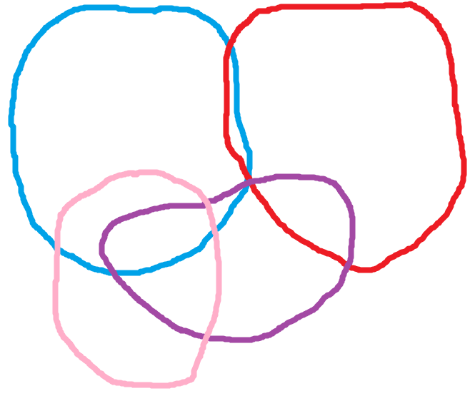
DOMAIN : Woking Definition- Recognisable part of our life with distinctive contexts, situations, people, relationships, environments, material things, challenges, opportunities and activities. Domains may be separate or overlap they contain the things we attend to and care about.
Home, family
house/garden
Work, colleagues,
office, commute
Friends
social
activity
Interests,
Hobbies

Slide 8
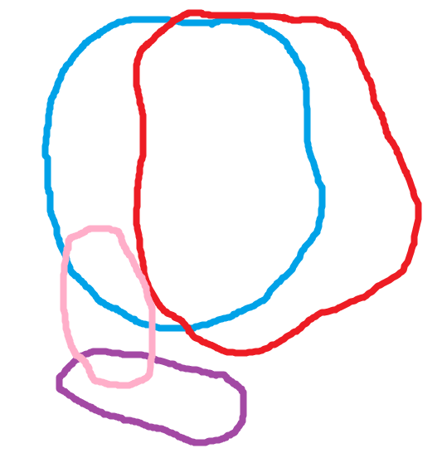
The form of a domains changes with time. The pandemic has had a major impact on the configuration, nature and scope of our domains.
Home, family
house/garden
Now involves
home schooling
Home Working
interacting with
colleagues online
and blending with
home activities
Interests,
Hobbies
NO TRAVEL or VACATION EXPERIENCES
Friends mainly online
social activity

Slide 9
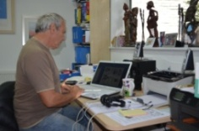
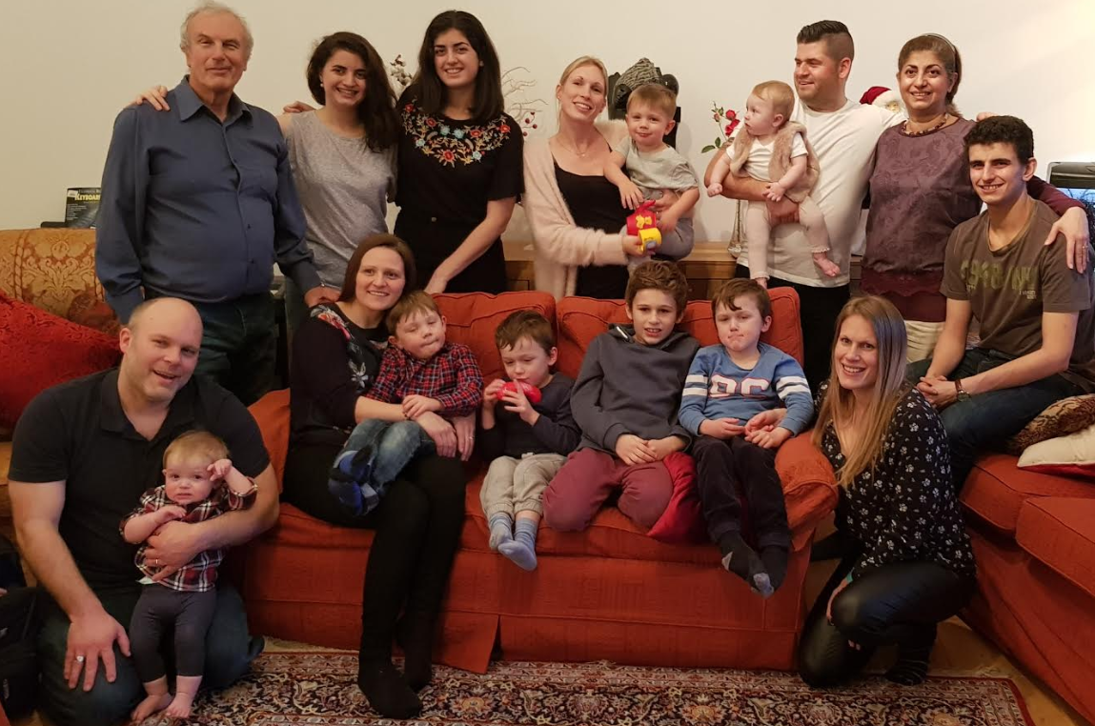
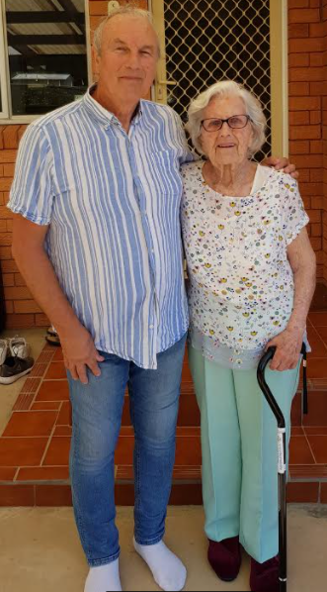
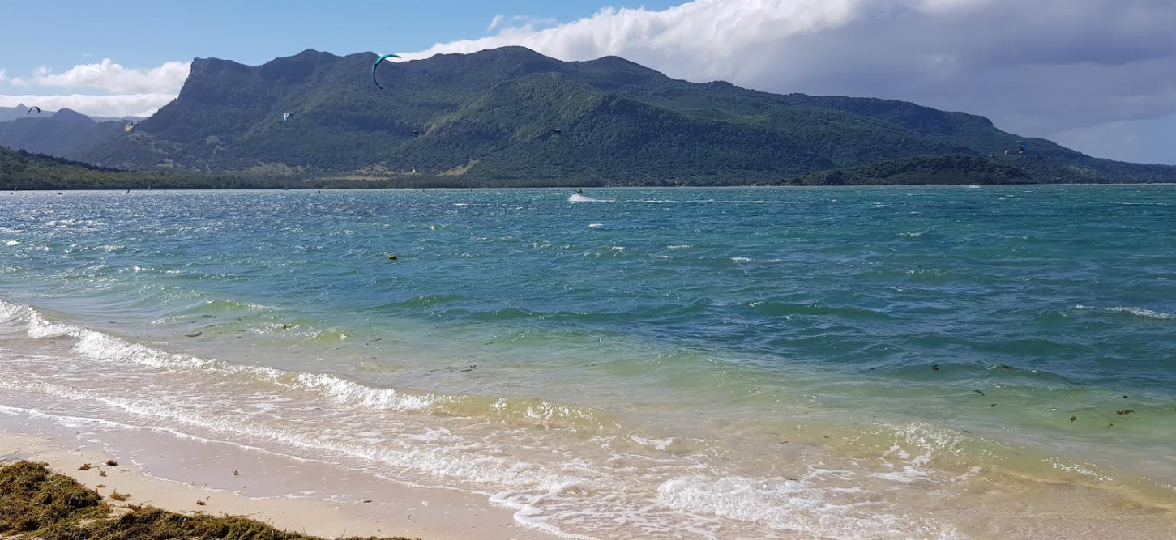
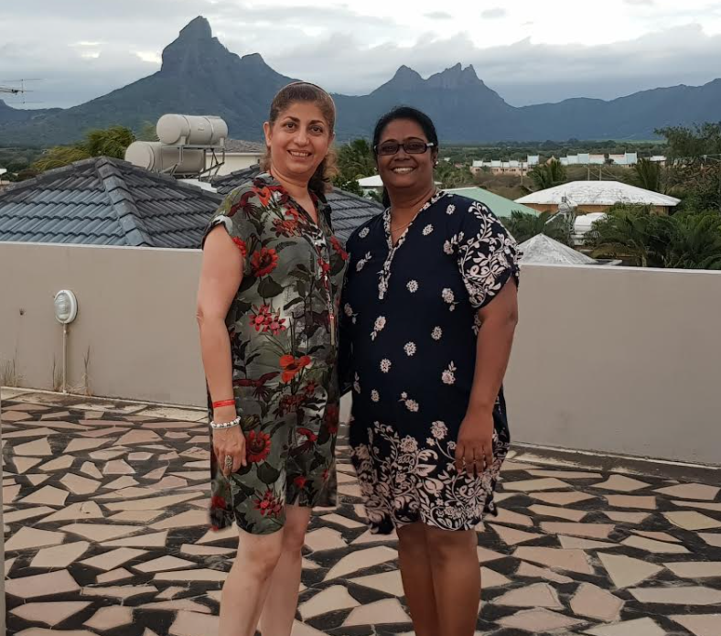
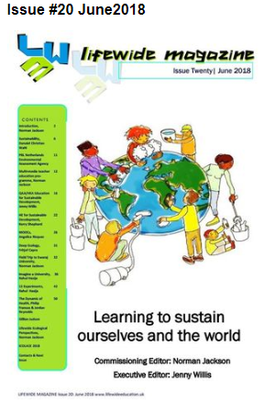
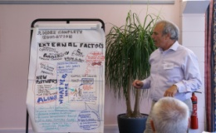
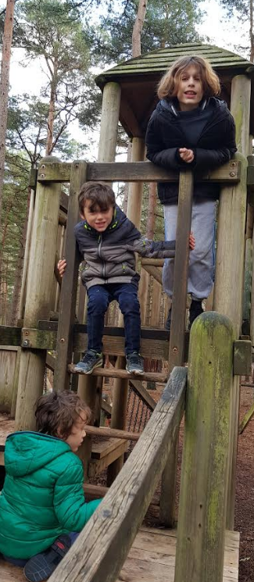
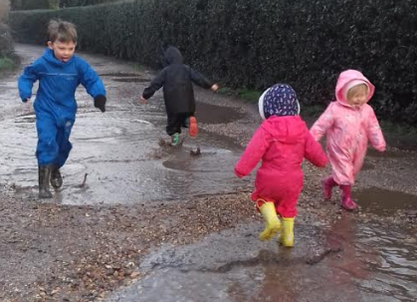
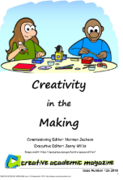
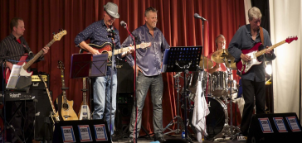
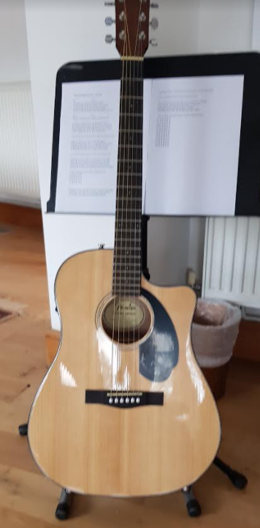
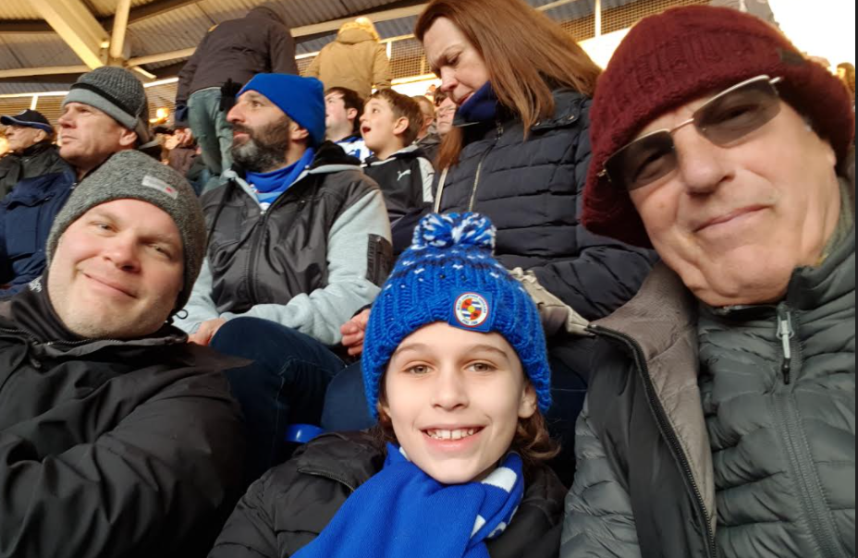
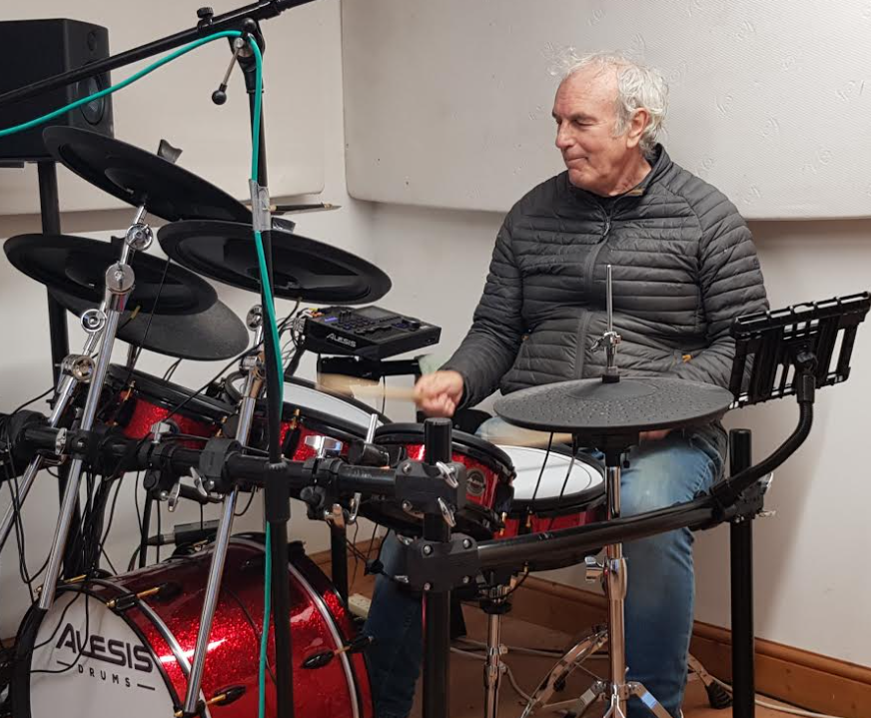
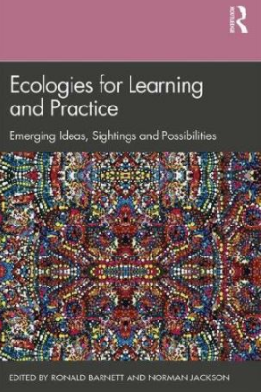
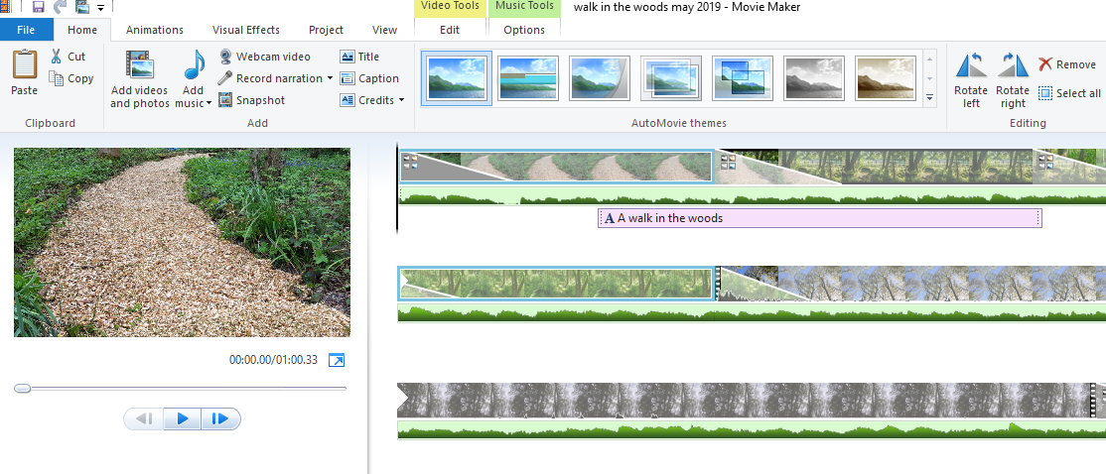
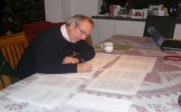
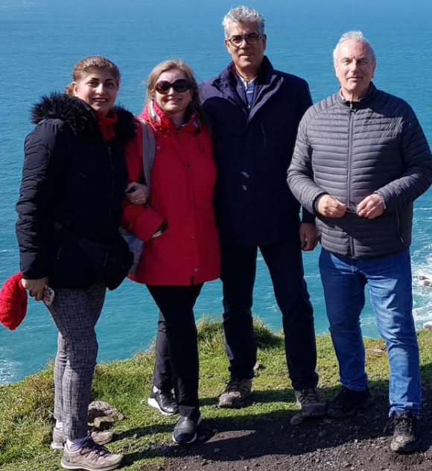
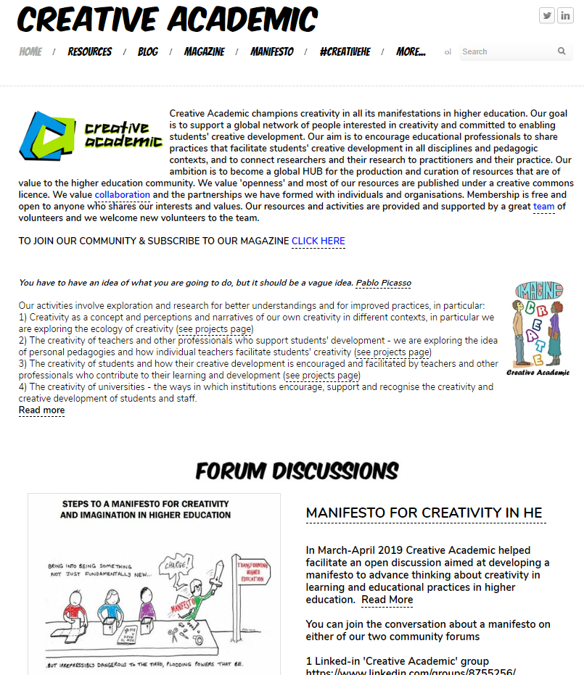
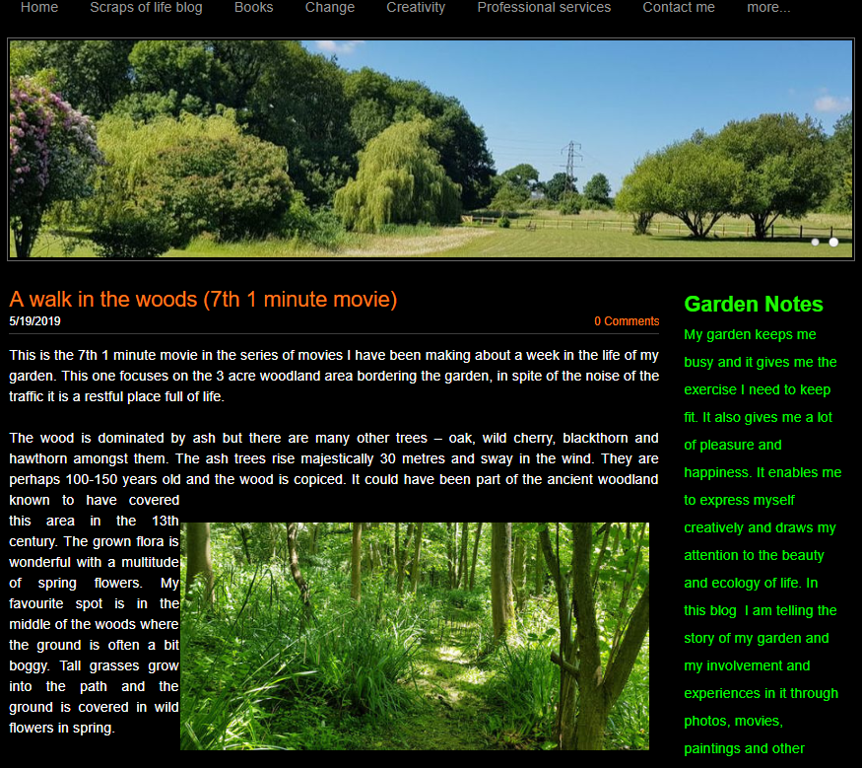
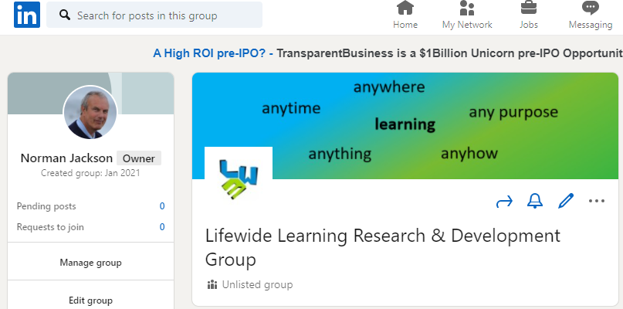
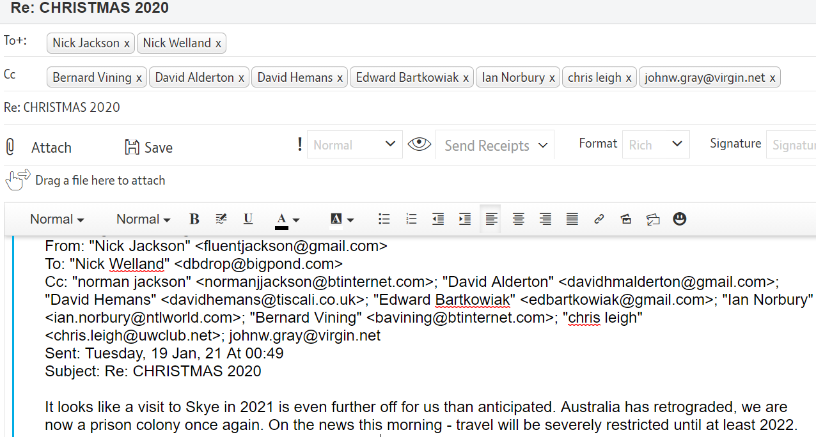
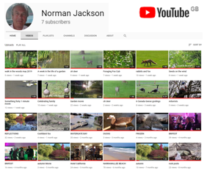
family & home
travel – anywhere
AUSTRALIA
MAURITUS
hobbies
work/scholarship
publishing
friends
using technology /social media

Slide 10
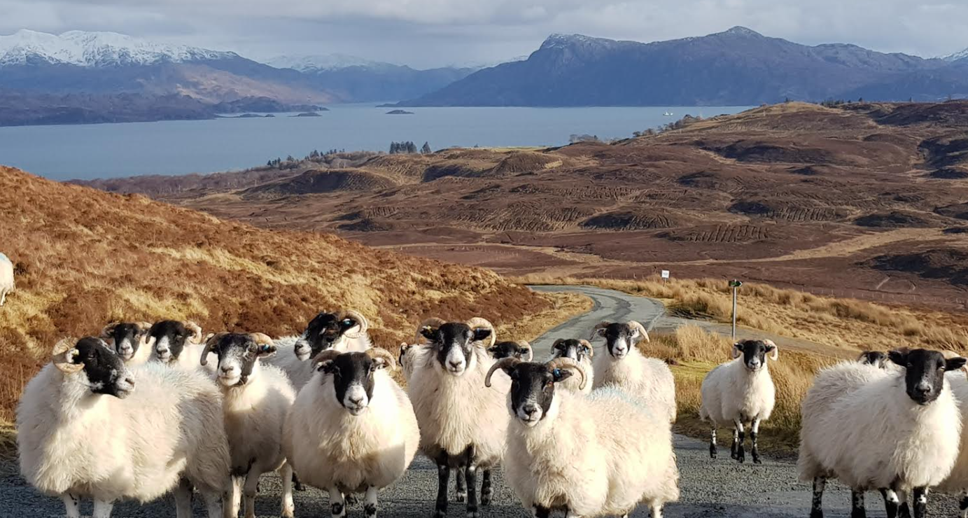
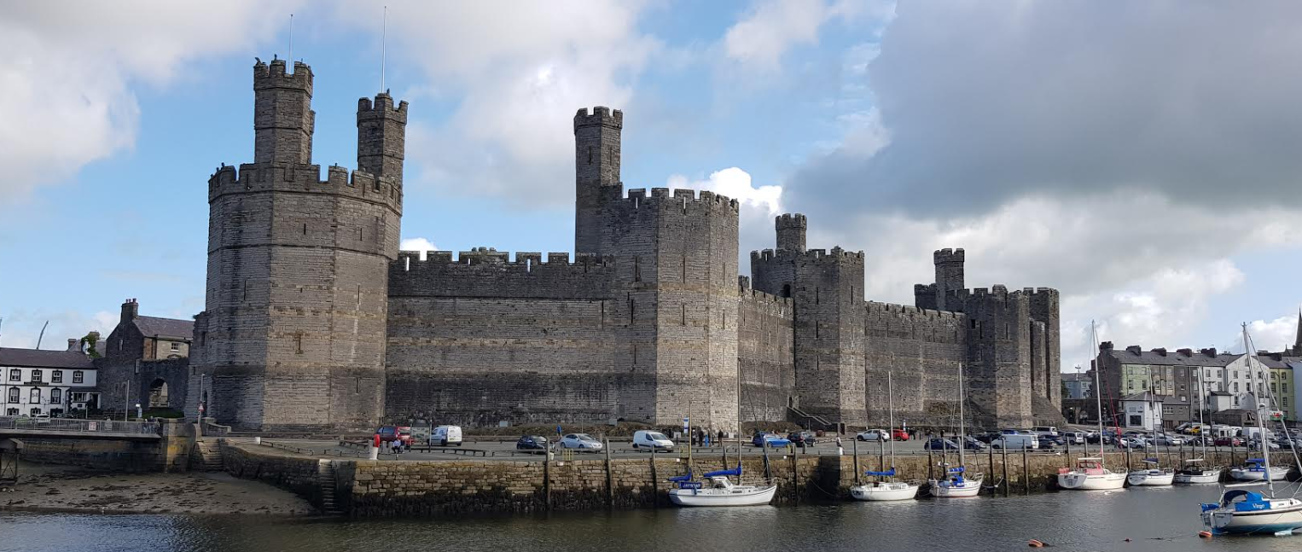
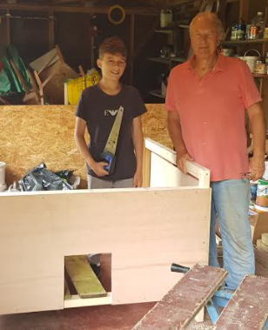
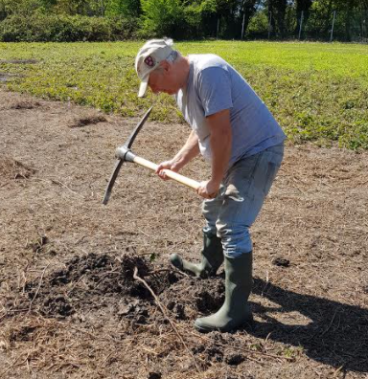
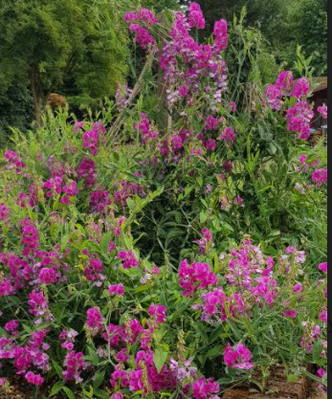
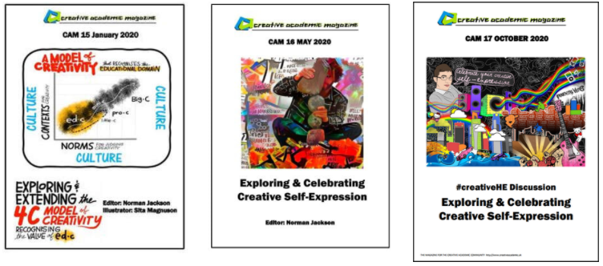
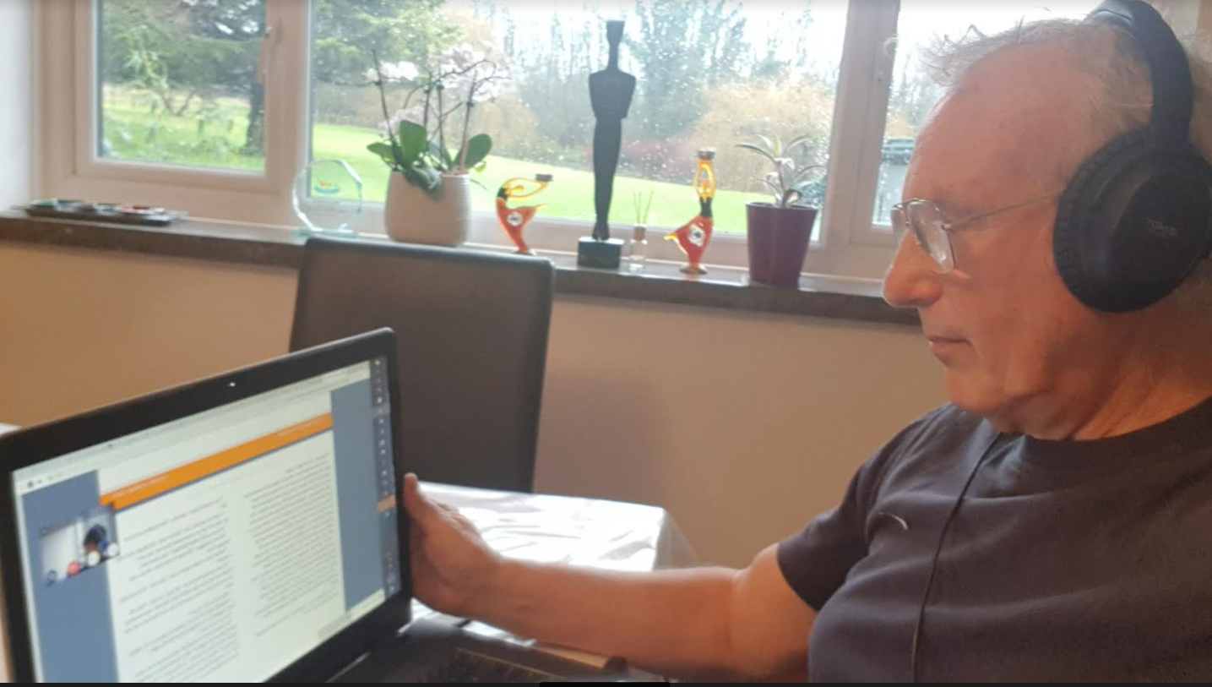
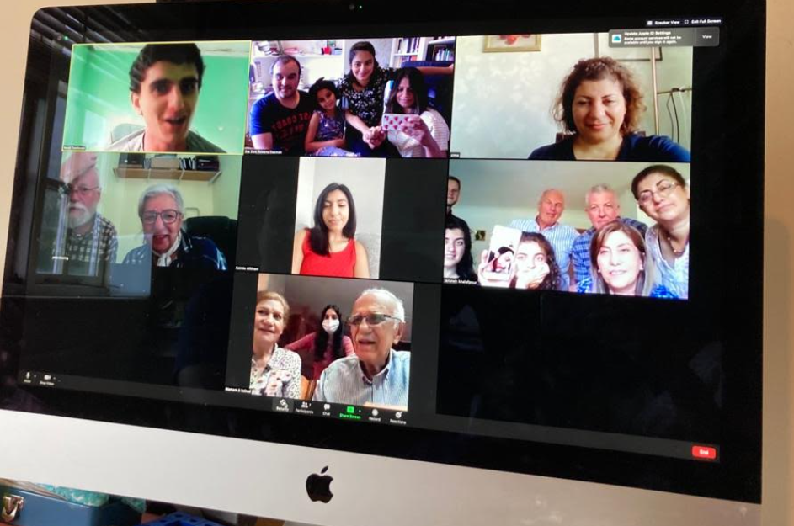
X
family & home
foreign travel – other cultures
limited travel within UK – no travel for work
/
X
X
X
work/scholarship/publishing
X
hobbies
using technology /social media
X
Tv
TUTORING
chickens
friends

Slide 11
Family & Home
Virtually No
Travel at
Moment
Large family – always someone I can help
or support.
Home & garden
always jobs to do & problems to solve
Work
Writing – books & articles
Editing & publishing magazines
Conducting research
Consultancy
Facilitation
Running two enterprises Interacting with people online
Interests & hobbies
Gardening
Making movies
Playing guitar and drums
Playing drums in a band
Recording music
Painting for fun
Friends
Social interactions
e.g. home visits, trips
& holidays, playing in
the band, reunions
now mostly
interactions online
Virtual World
Building/maintaining websites, participating in different social media spaces, email. Essential for work & social interaction, interests, learning and entertainment

Slide 12
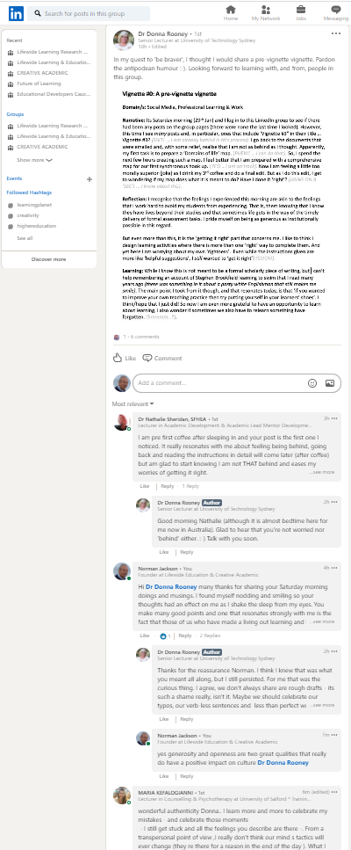
Diagram adapted from Max Boisot (1998)
Symbolic
text-book
knowledge
EXPLICIT
codified
CONCEPTS
PRINCIPLES
PRACTICAL
LESSONS
MEANING
VIGNETTES
Reflective Narratives
CREATING
TACIT
uncodified
Embodied knowledge
Enacted experience
concrete
abstract
Enaction – people create their own experience through their actions
Enactivism – cognition/emotion arise through dynamic interactions
between a person and their environment.

Slide 13
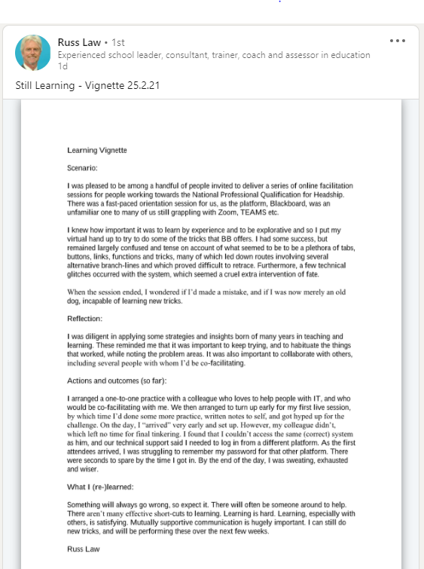
Max 1 page (A4)
Title : The substantive theme
Domain: Identifies the part of your life in which the experience occurred
Narrative: describing an experience that was meaningful from any life domain. Please provide information on context, situations, the environment and how learning emerged.
5 Reflections: on what was learnt & why it
was meaningful plus any insights and
principles relating to everyday learning
5 Please share in LinkedIn discussion space

Slide 14
LinkedIn space is private. Only participants can access it.
Participants can delete vignettes at the end of the process.
Lifewide Education will create thematic summaries drawing on vignettes to be posted in discussion space.
Summaries will quote from vignettes but individuals will not be identified
Thematic summaries will be used to produce Lifewide Magazine#24
We may quote from vignettes but individuals will not be identified
We will invite participants to prepare an article for the magazine (1200 words) drawing on their vignettes & experiences of lifewide learning.
We may invite some participants to include their vignettes in the Magazine

